Slide 1


Pwning IoT via Hardware Attacks
Chase Schultz, Senior Security Consultant cschultz@securityevaluators.com

Slide 2




About ISE
Perspective
White box
Analysts
Hackers; Cryptographers; RE
Exploits
iPhone; Android; Ford; Exxon; Diebold
Research
Routers; NAS; Healthcare
Customers
Companies with high value assets

Slide 3
whoami
Chase Schultz
Senior Security Consultant
Independent Security Evaluators
Twitter – @f47h3r_b0
Interests:
Reverse Engineering, Hardware, SDR, Fuzzing, Embedded Systems, Python & Go

Slide 4
Agenda
Importance of Hardware Hacking & IoT Research
Scope of Workshop
Hardware Hacking Background
Tools of the Trade
Methodology
Examples
Photo Journal
Hands On!!
Resources / Further Reading
Open it up to attendee’s. What do you want to see?

Slide 5
Why is this important?
Notes:
Talk about the current landscape of IoT… So many new products hitting the streets… Smart Home is here / So many personal devices / … Light Bulbs, Home Appliances, Lighting & Energy Control Systems.

Slide 6
A Journey of Pwnage
Started getting interested in Hardware Hacking & IoT
Software guy goes to school …
Great way to get access and leverage for further research.
Notes:
Need to Add Refrences

Slide 7




IoT?
IoT is a buzzword (duh) …
Lots of embedded devices doing all the things …
Smart Homes
Medical Devices / Entertainment / Health Fitness / Toys / Sensors etc

Slide 8
Hardware Hacking
Interfaces
UART (Universal Asynchronous Receive & Transmit)
JTAG (Joint Test Action Group) – HW Debug
SPI (Serial Peripheral Interface)
I2C (Inter-Integrated Circuit)

Slide 9
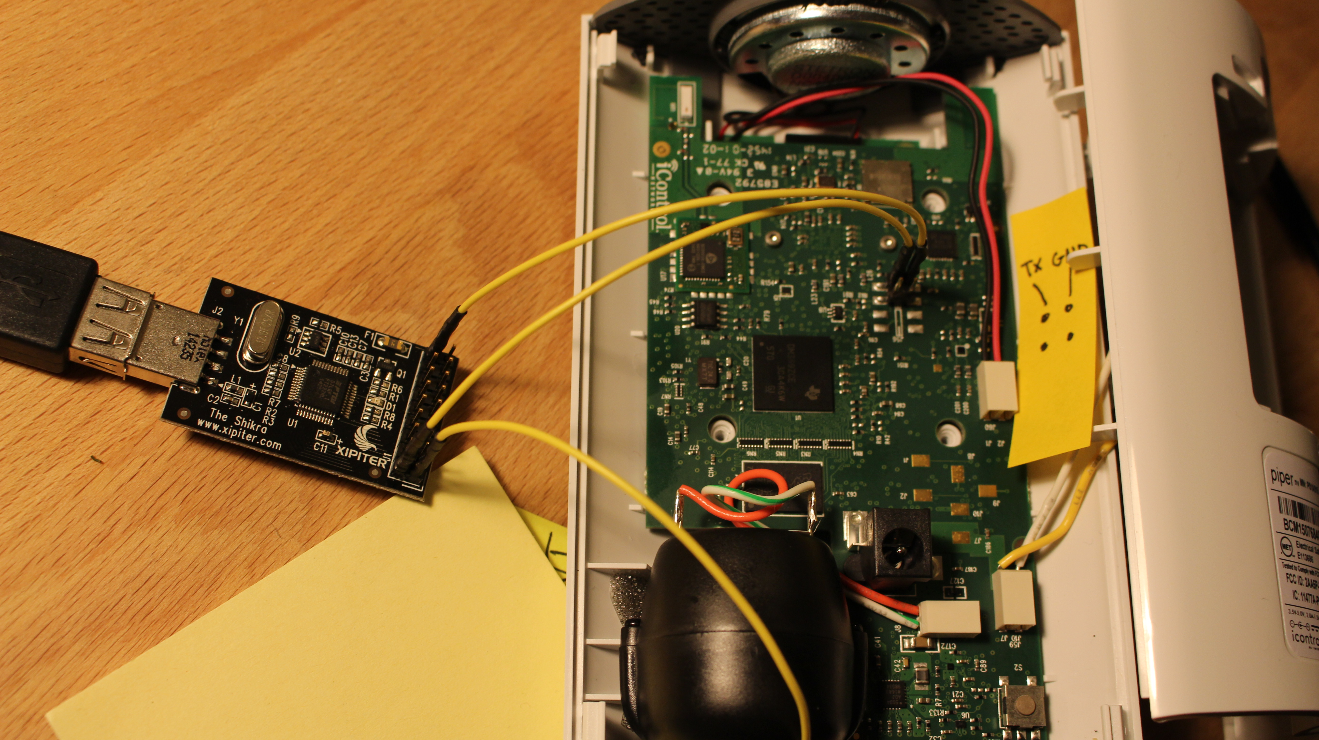
Notes:
Piper Night Vision Camera and Home Automation System

Slide 10
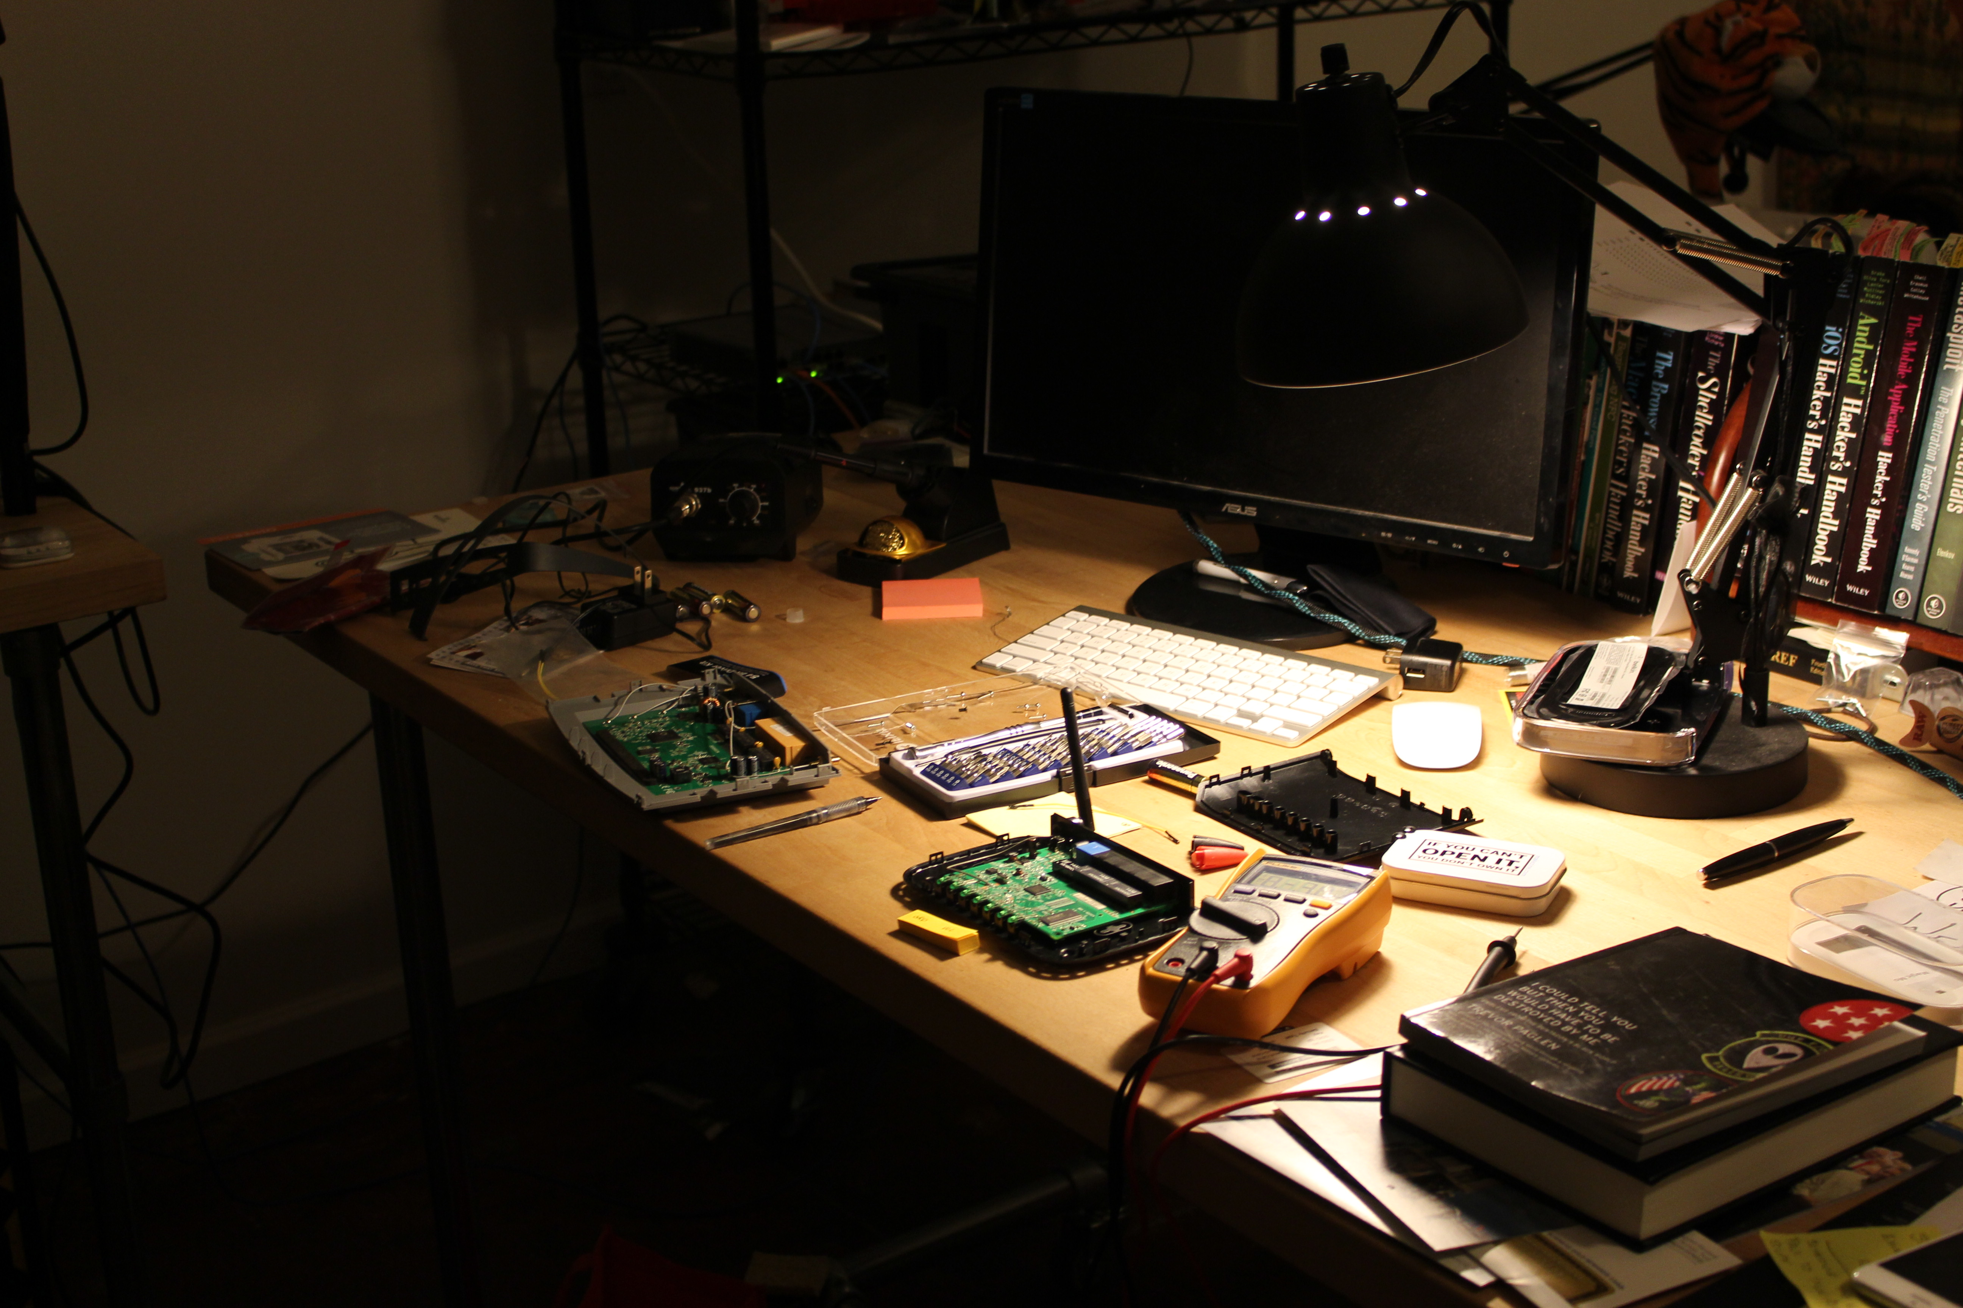
Tools of the Trade

Slide 11
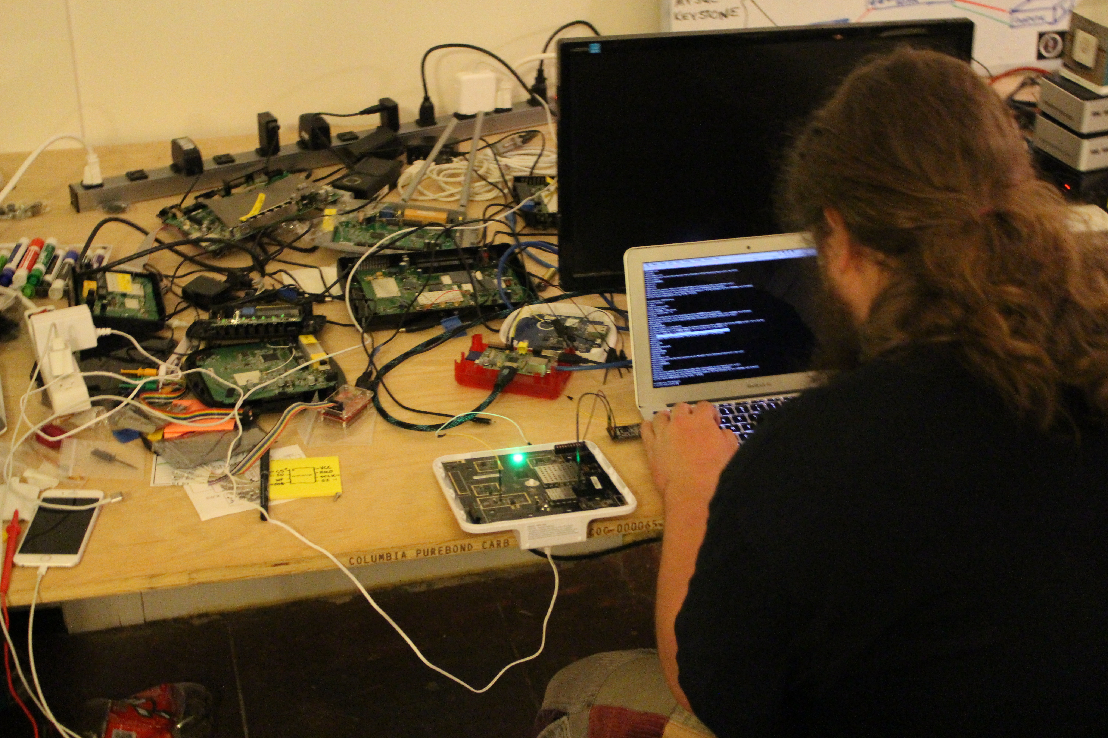

Slide 12
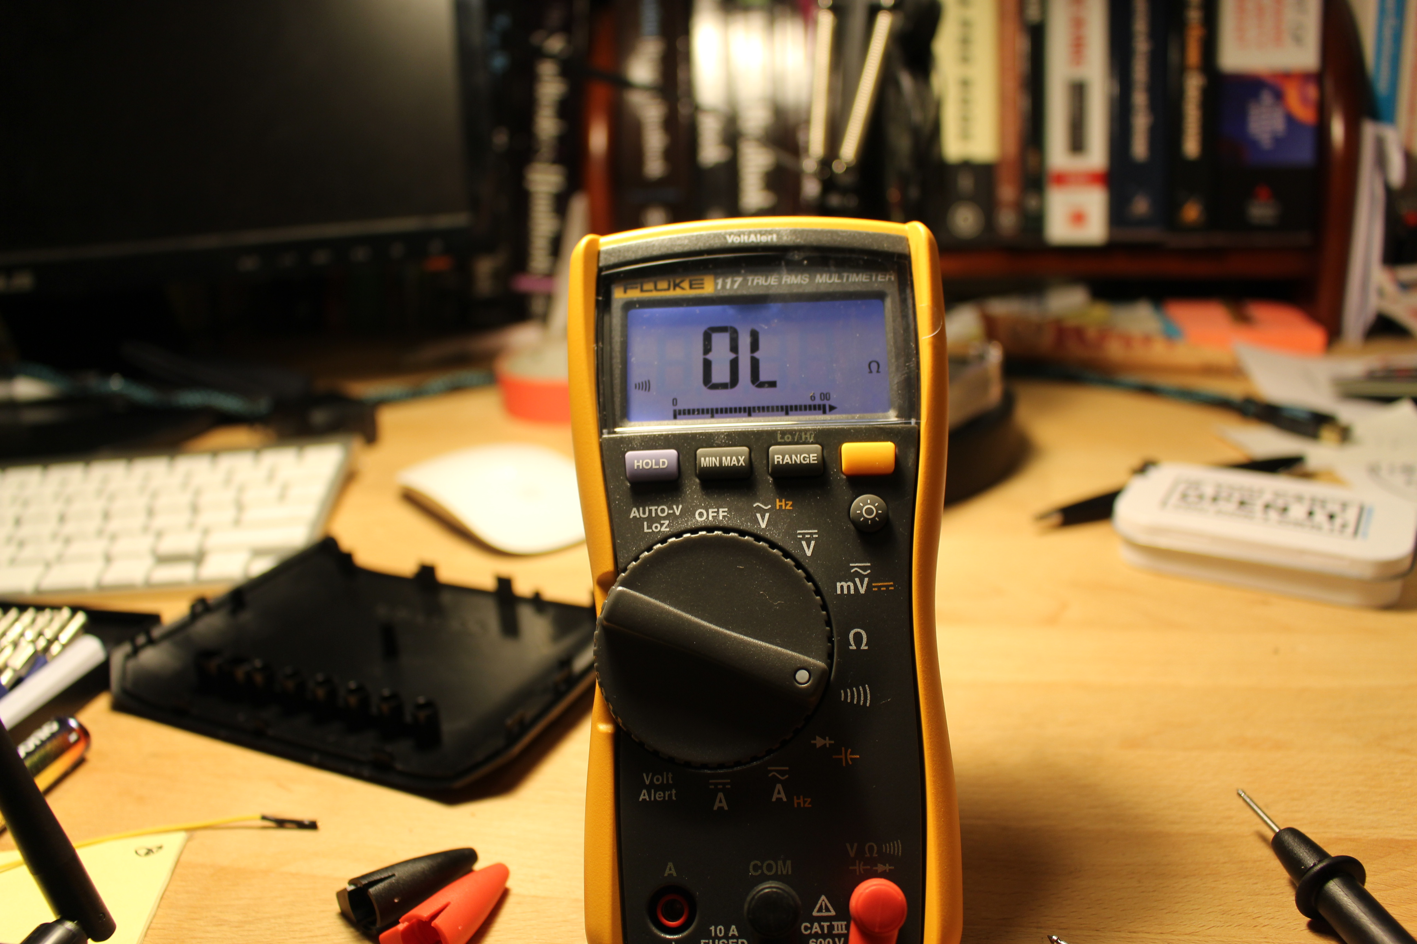

Slide 13
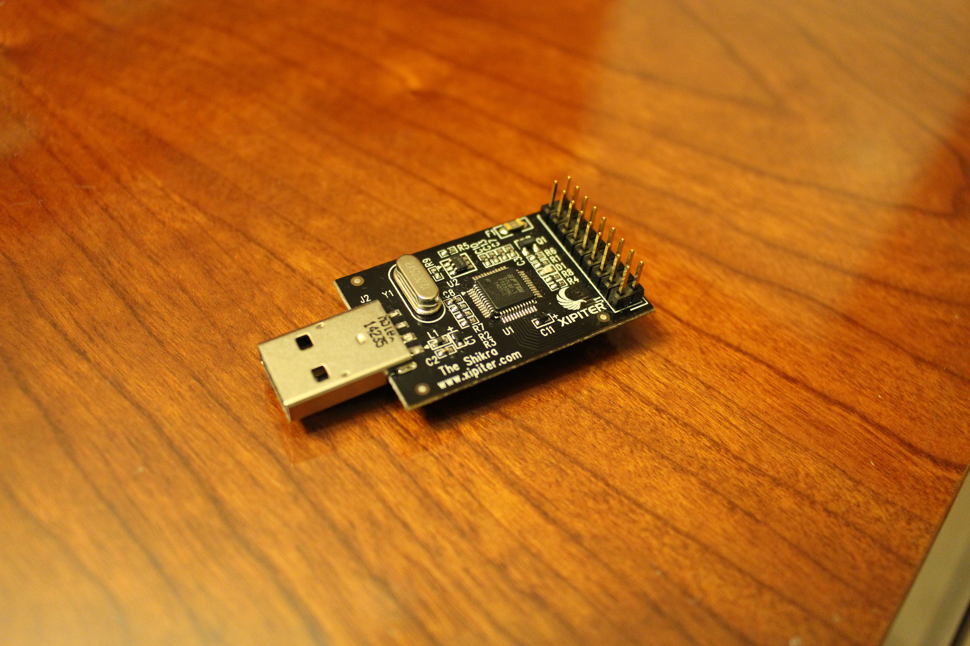

Slide 14
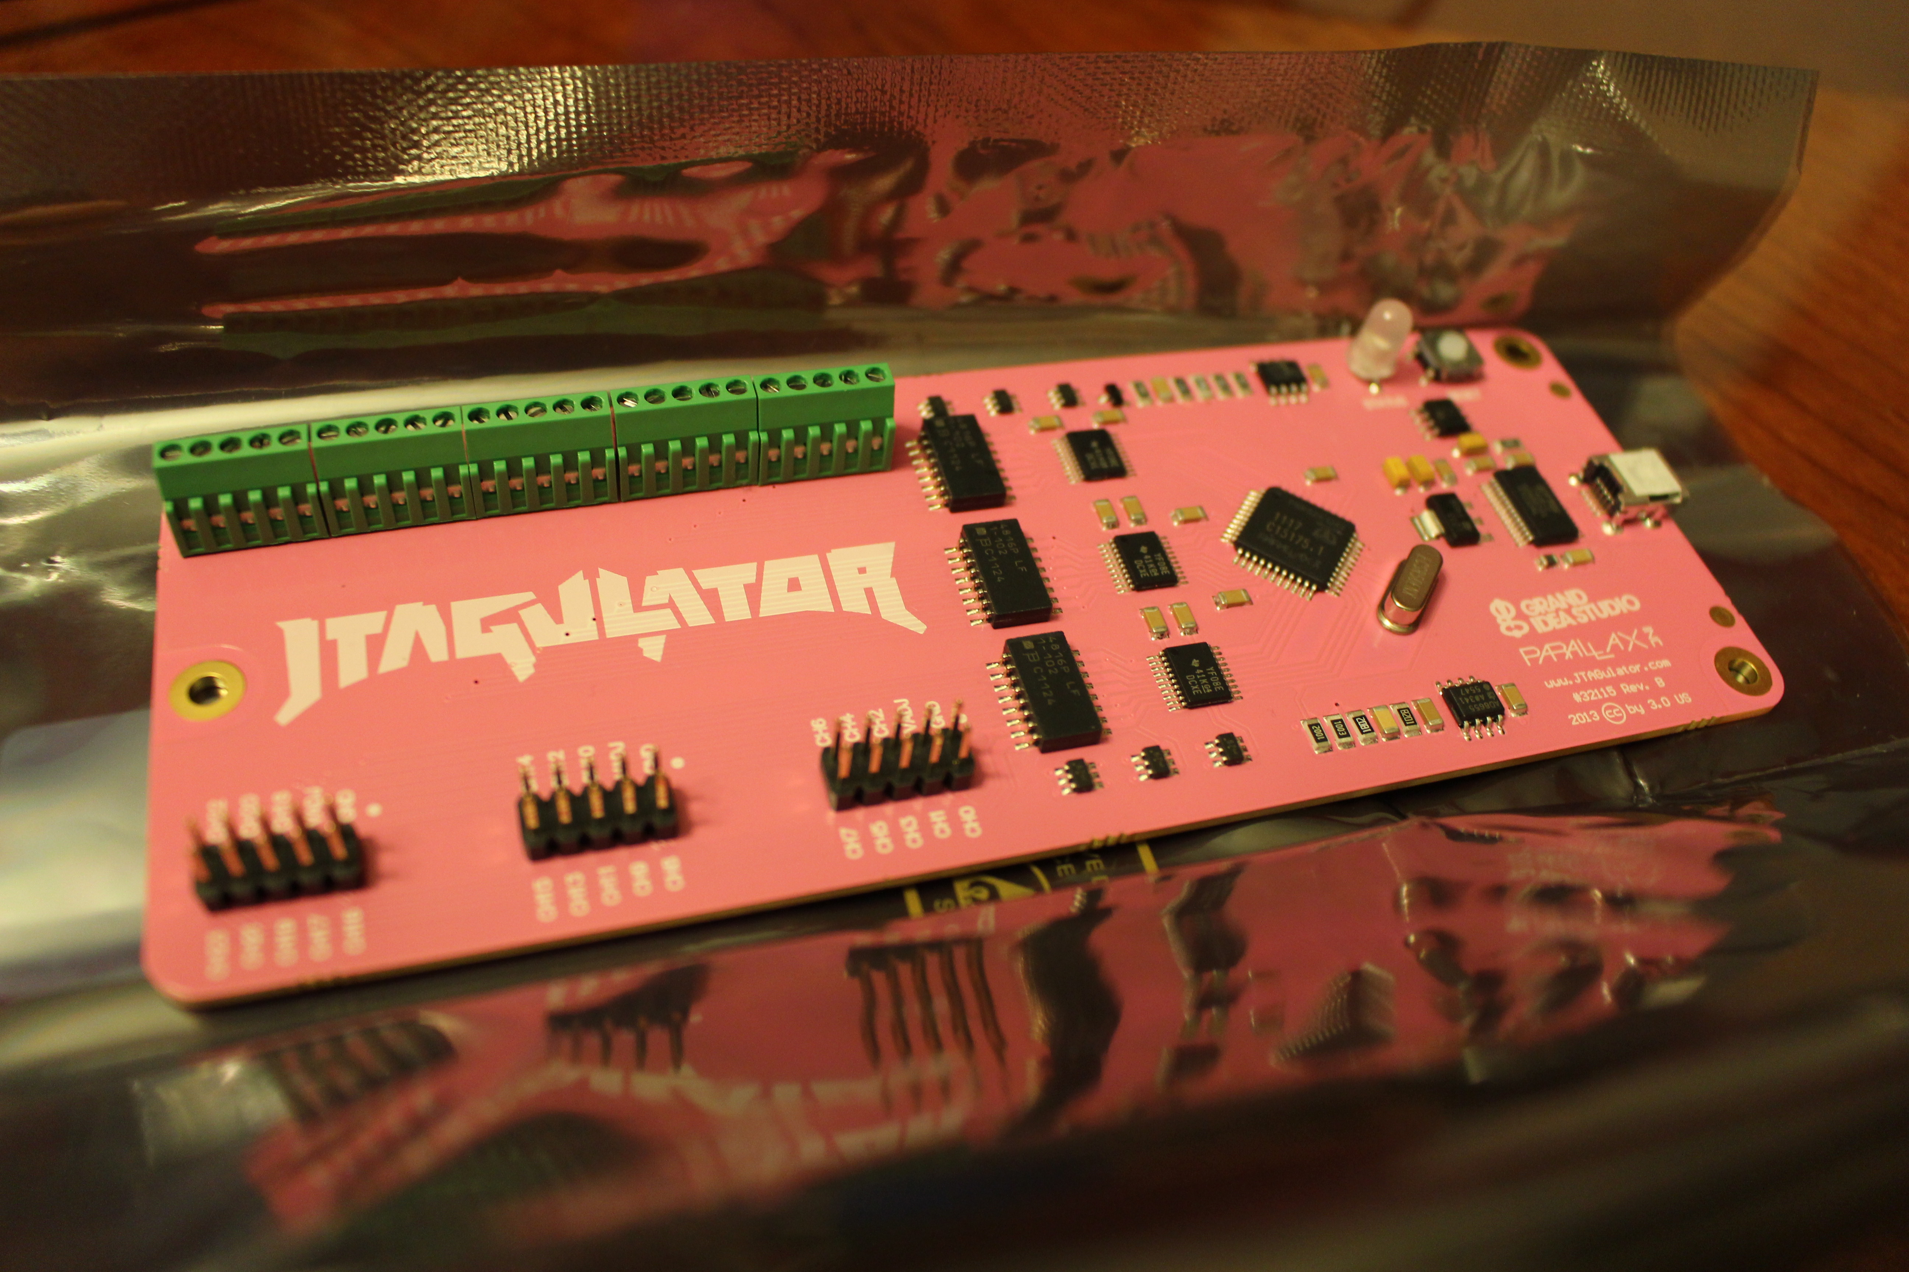

Slide 15
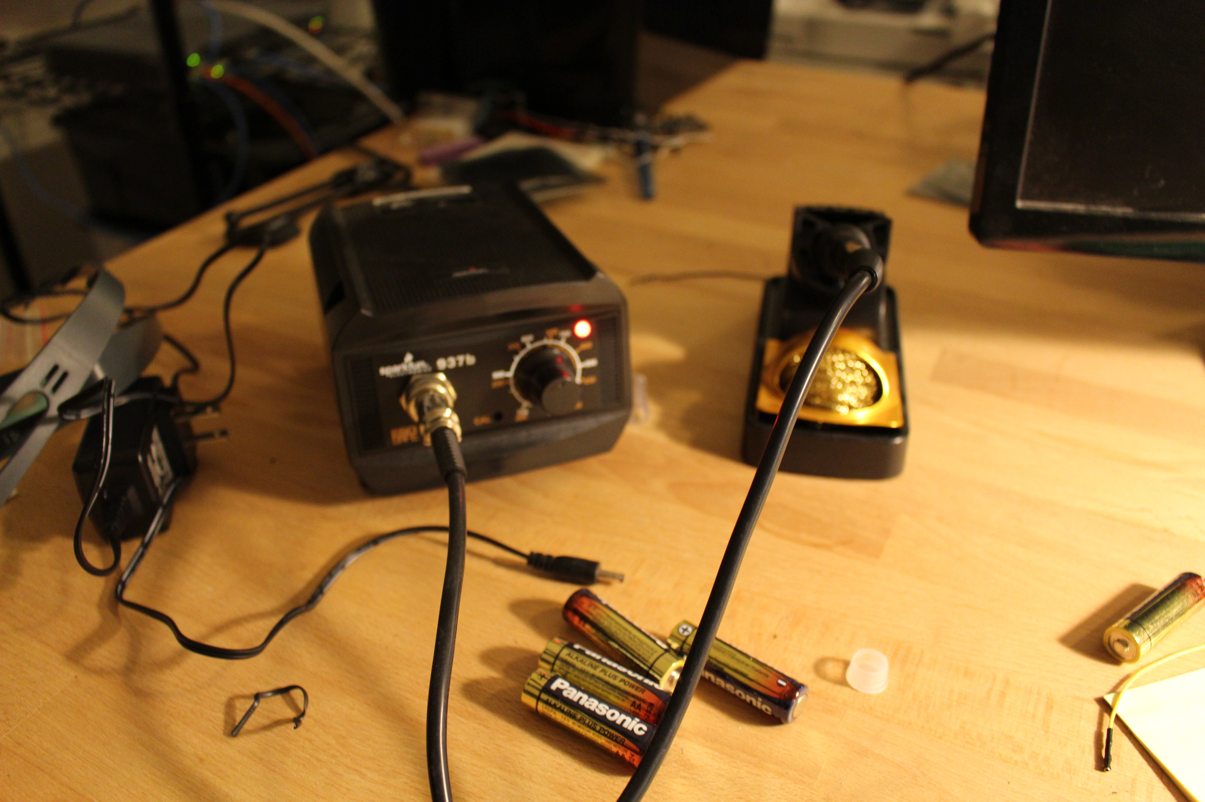

Slide 16
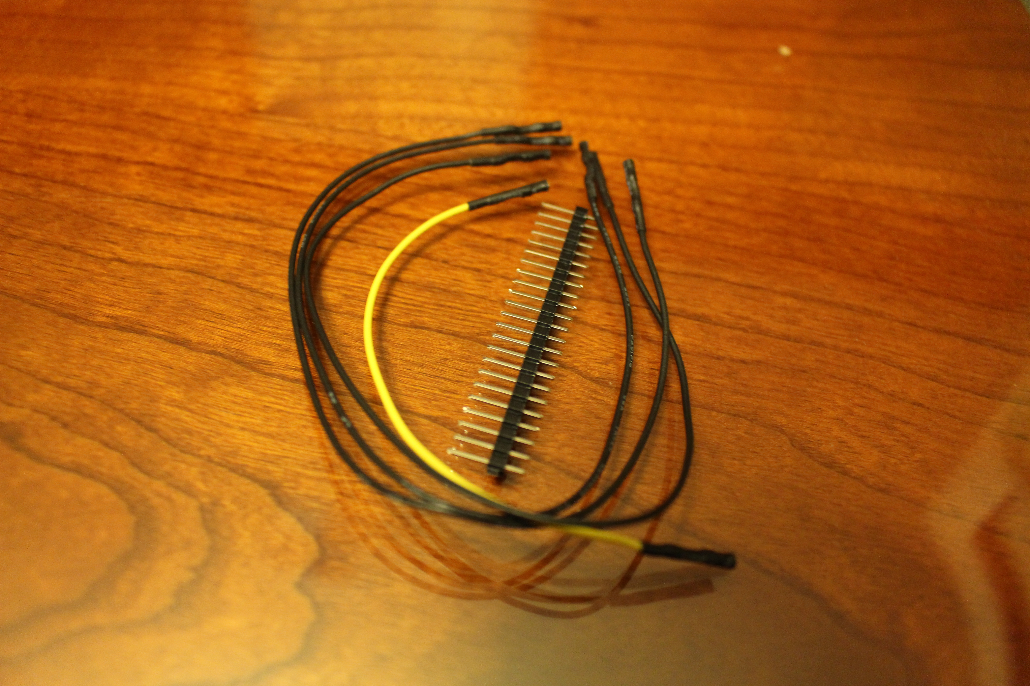

Slide 17
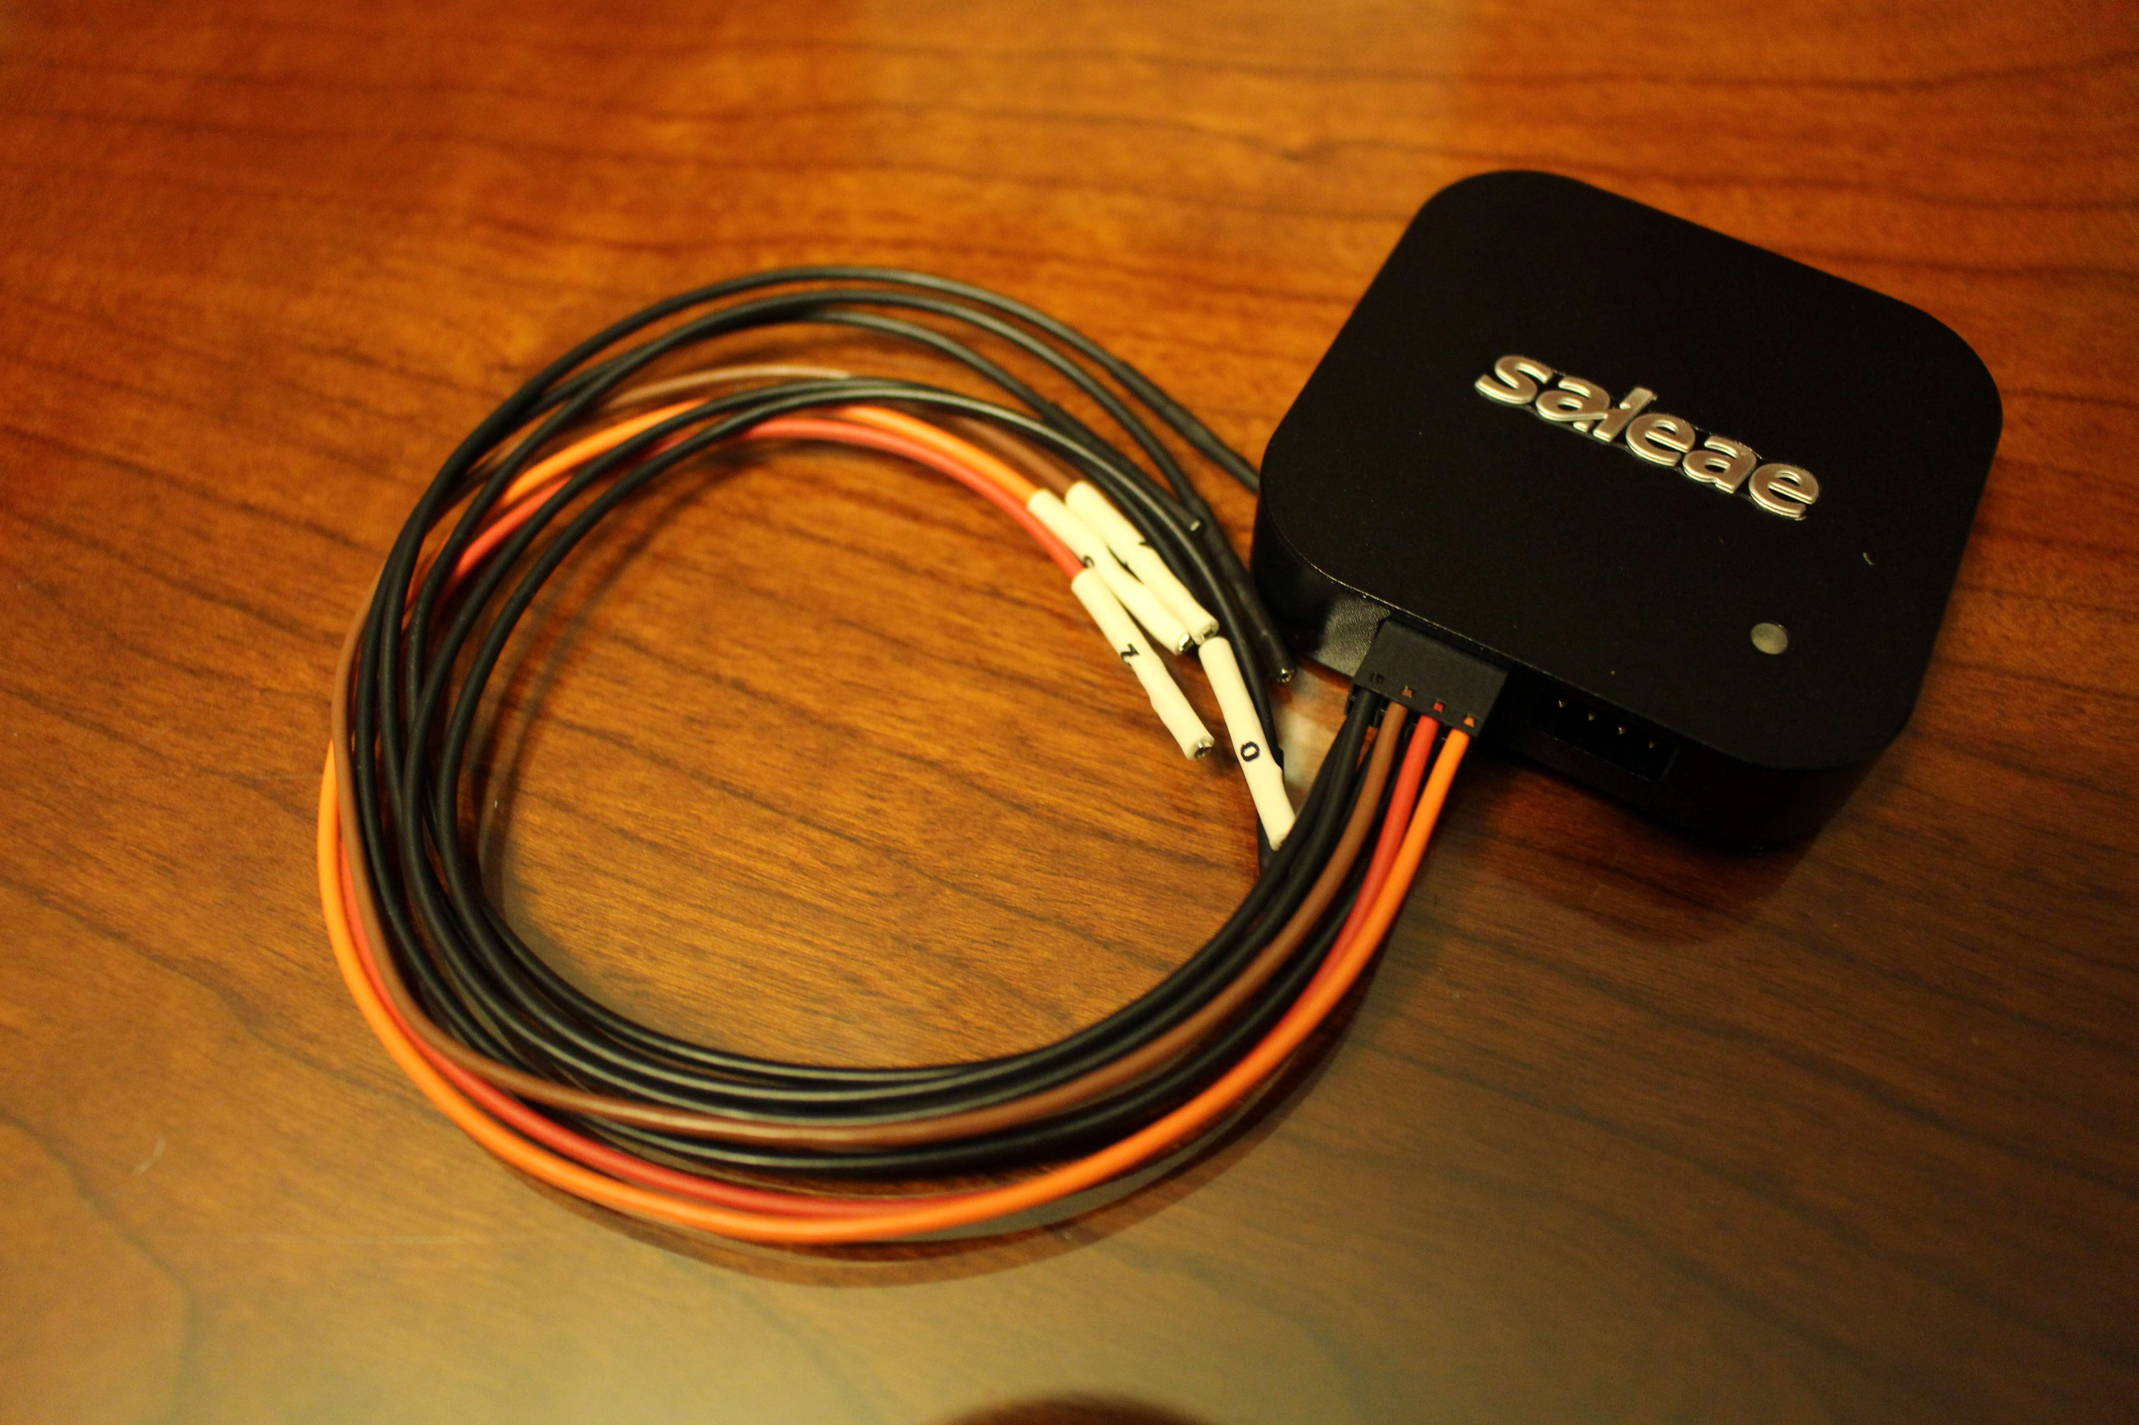

Slide 18
Hardware Attacks (Methodology)
0) Open the device, void your warranty, and join the exploitation party.
Identify Device, hardware revisions, document hardware components
Research chip datasheets - figure out features
Identify hardware communication interfaces possibilities
Continuity Testing and Electrical Pinout Reversing
Identifying wireline protocol logic (How the hell do I talk to these chips?)
Hardware tools for accessing interfaces
Wiring up to to the board
Device Interrogation
Firmware Reverse Engineering
Vulnerability Research / Exploitation

Slide 19
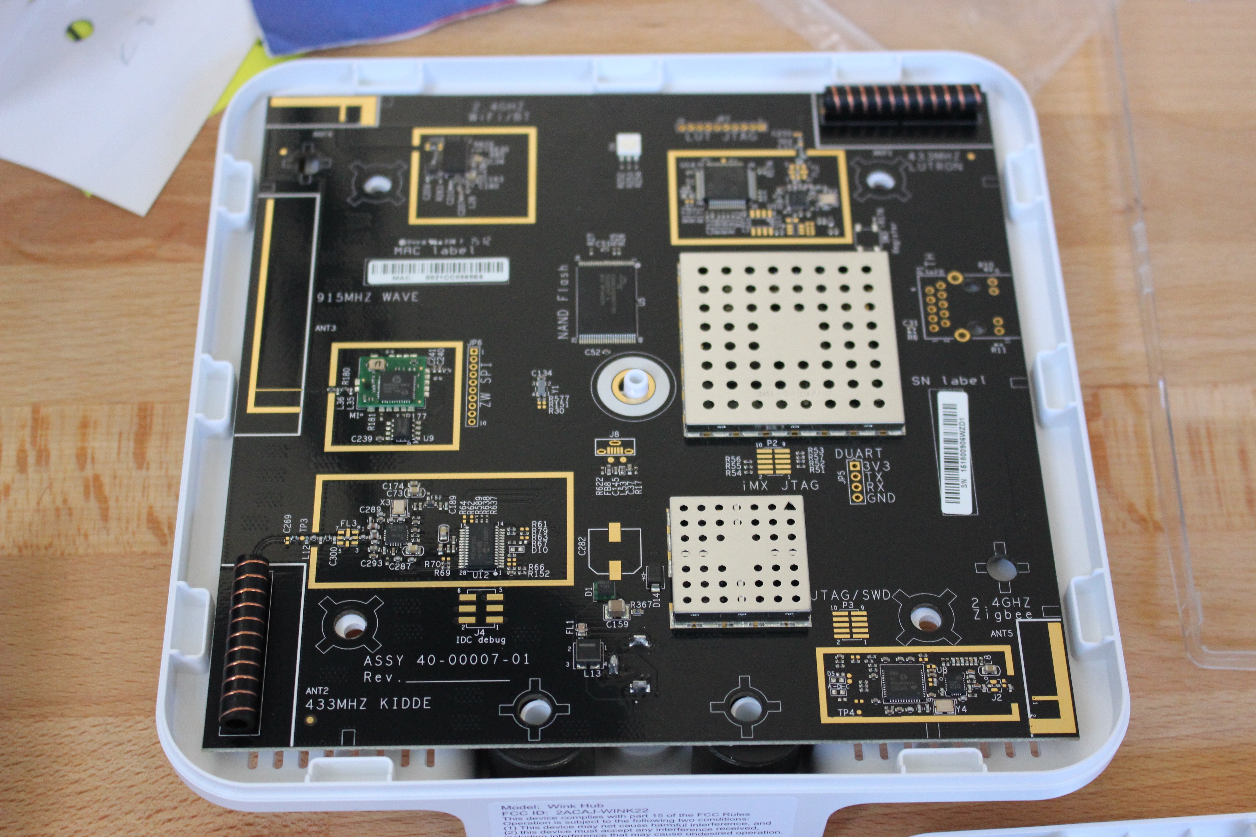
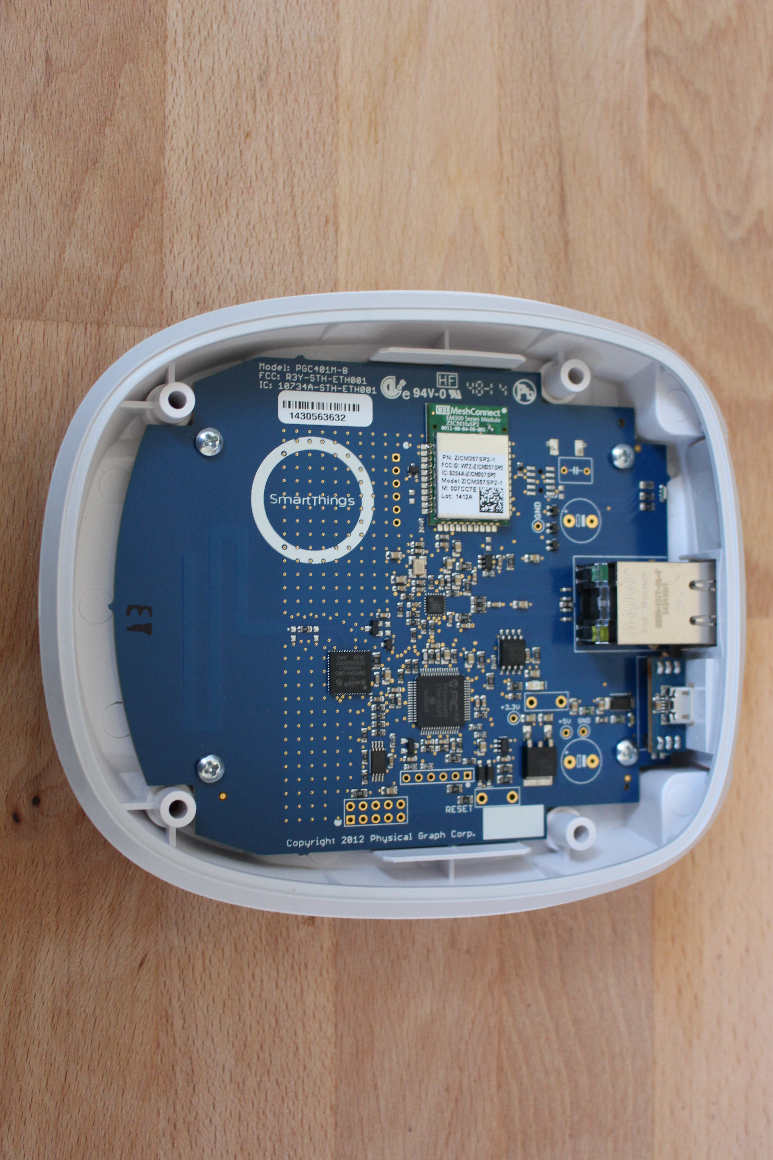
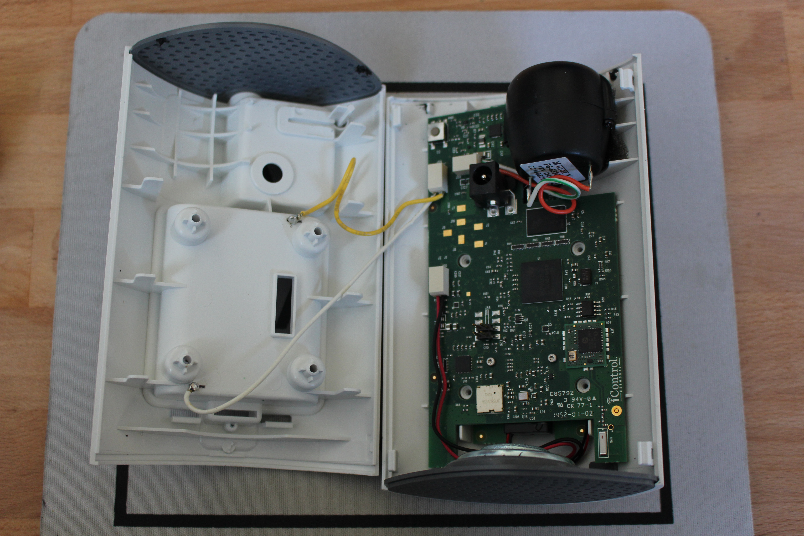
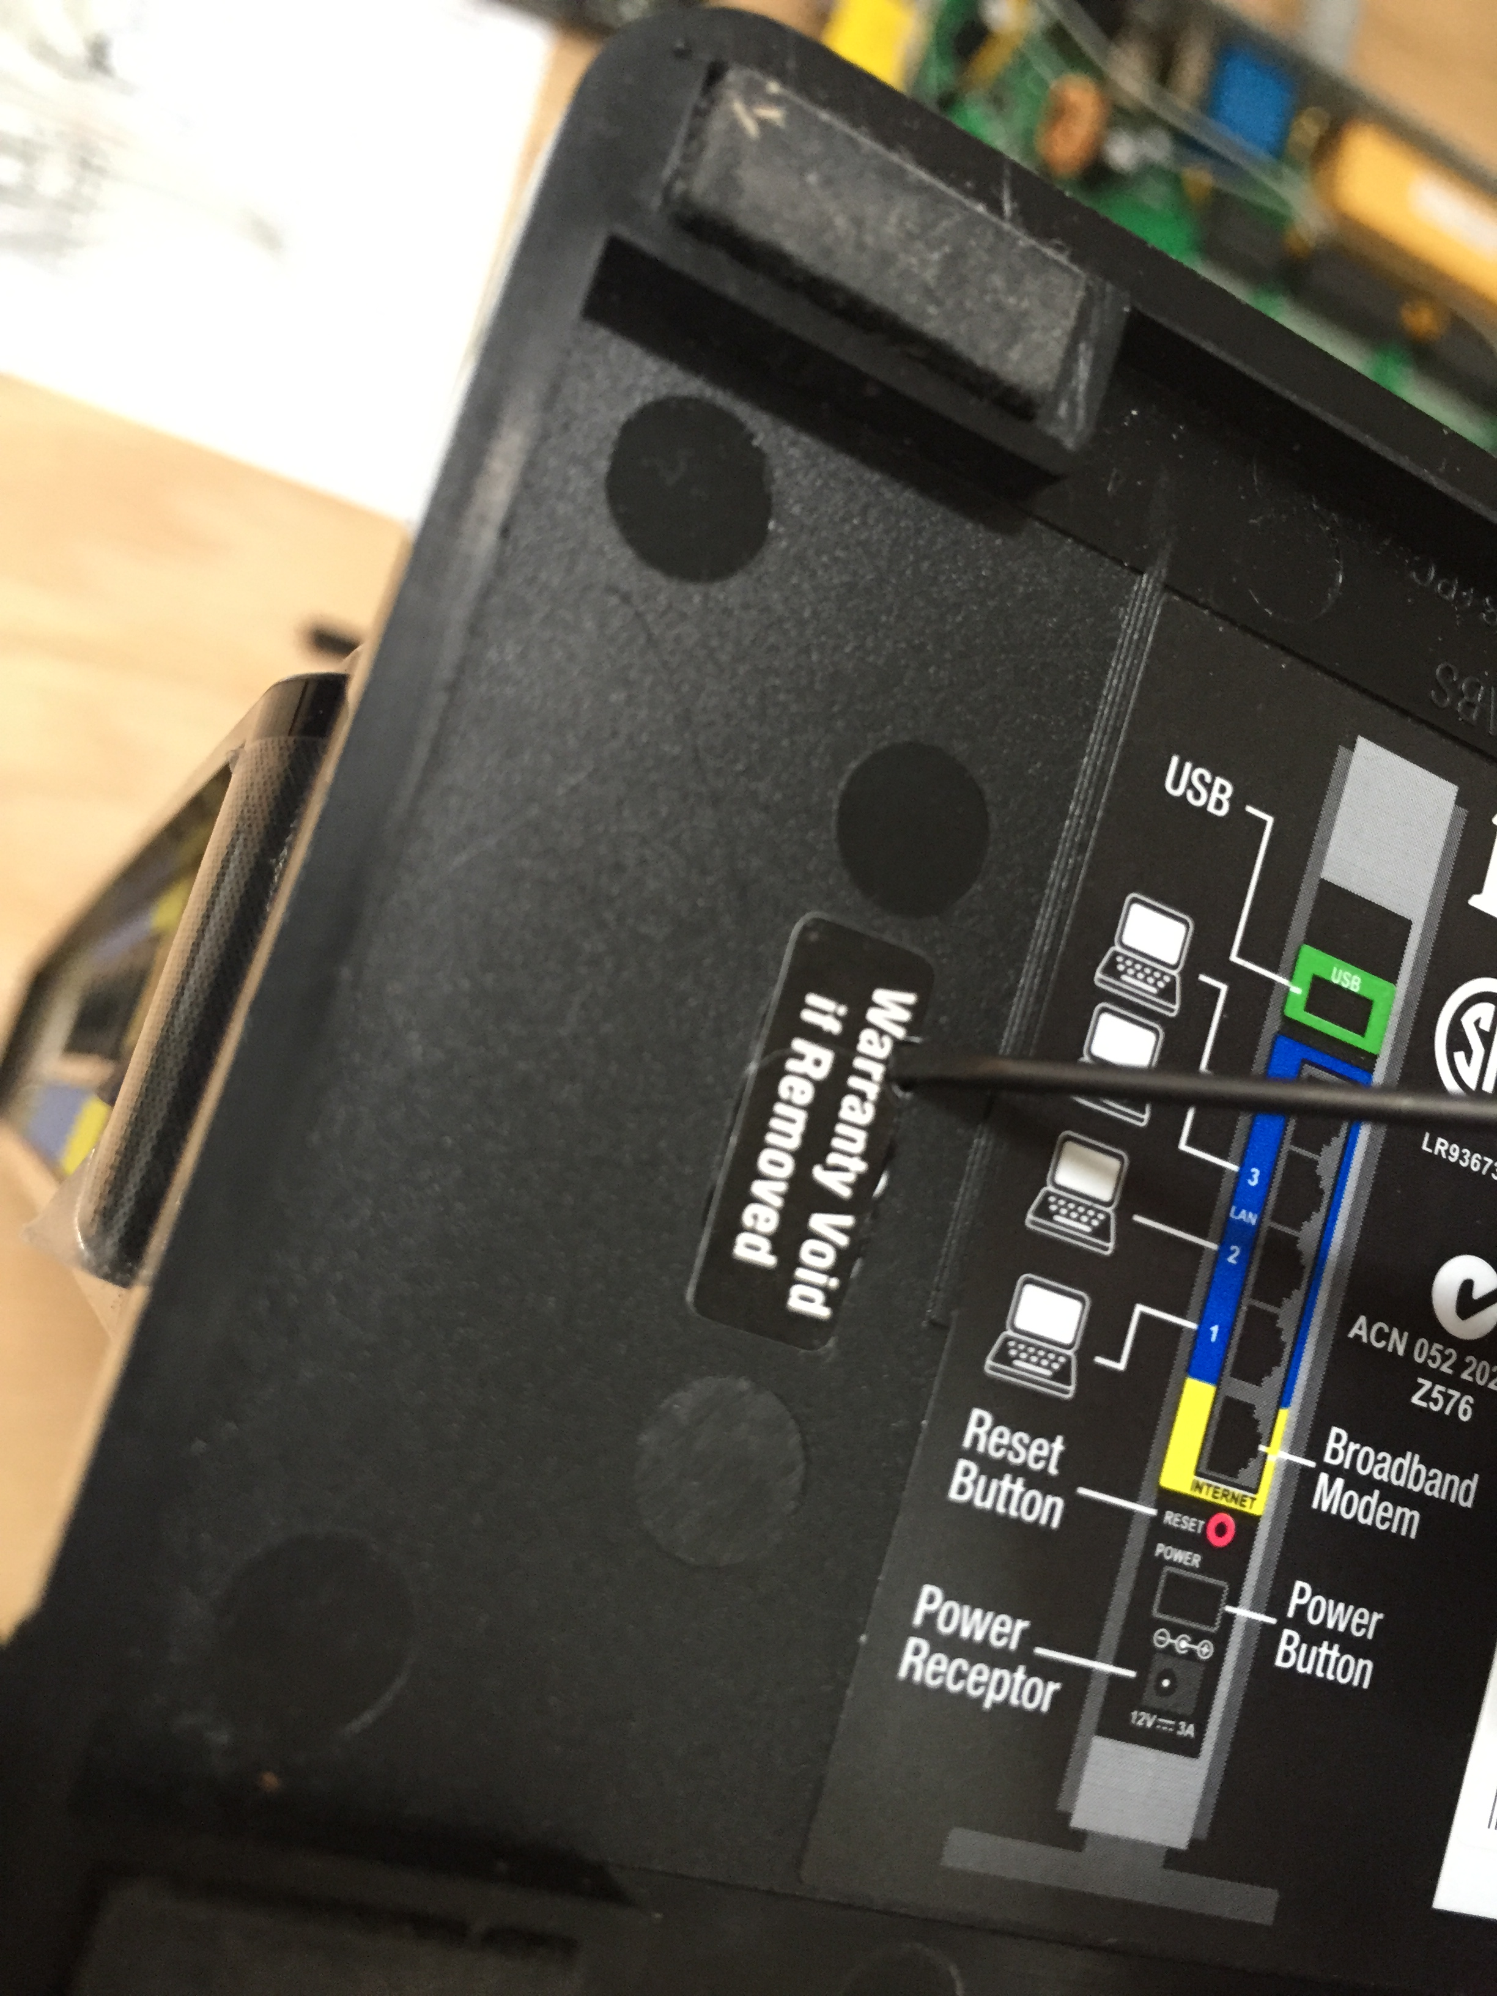
Void Some Warranties

Slide 20
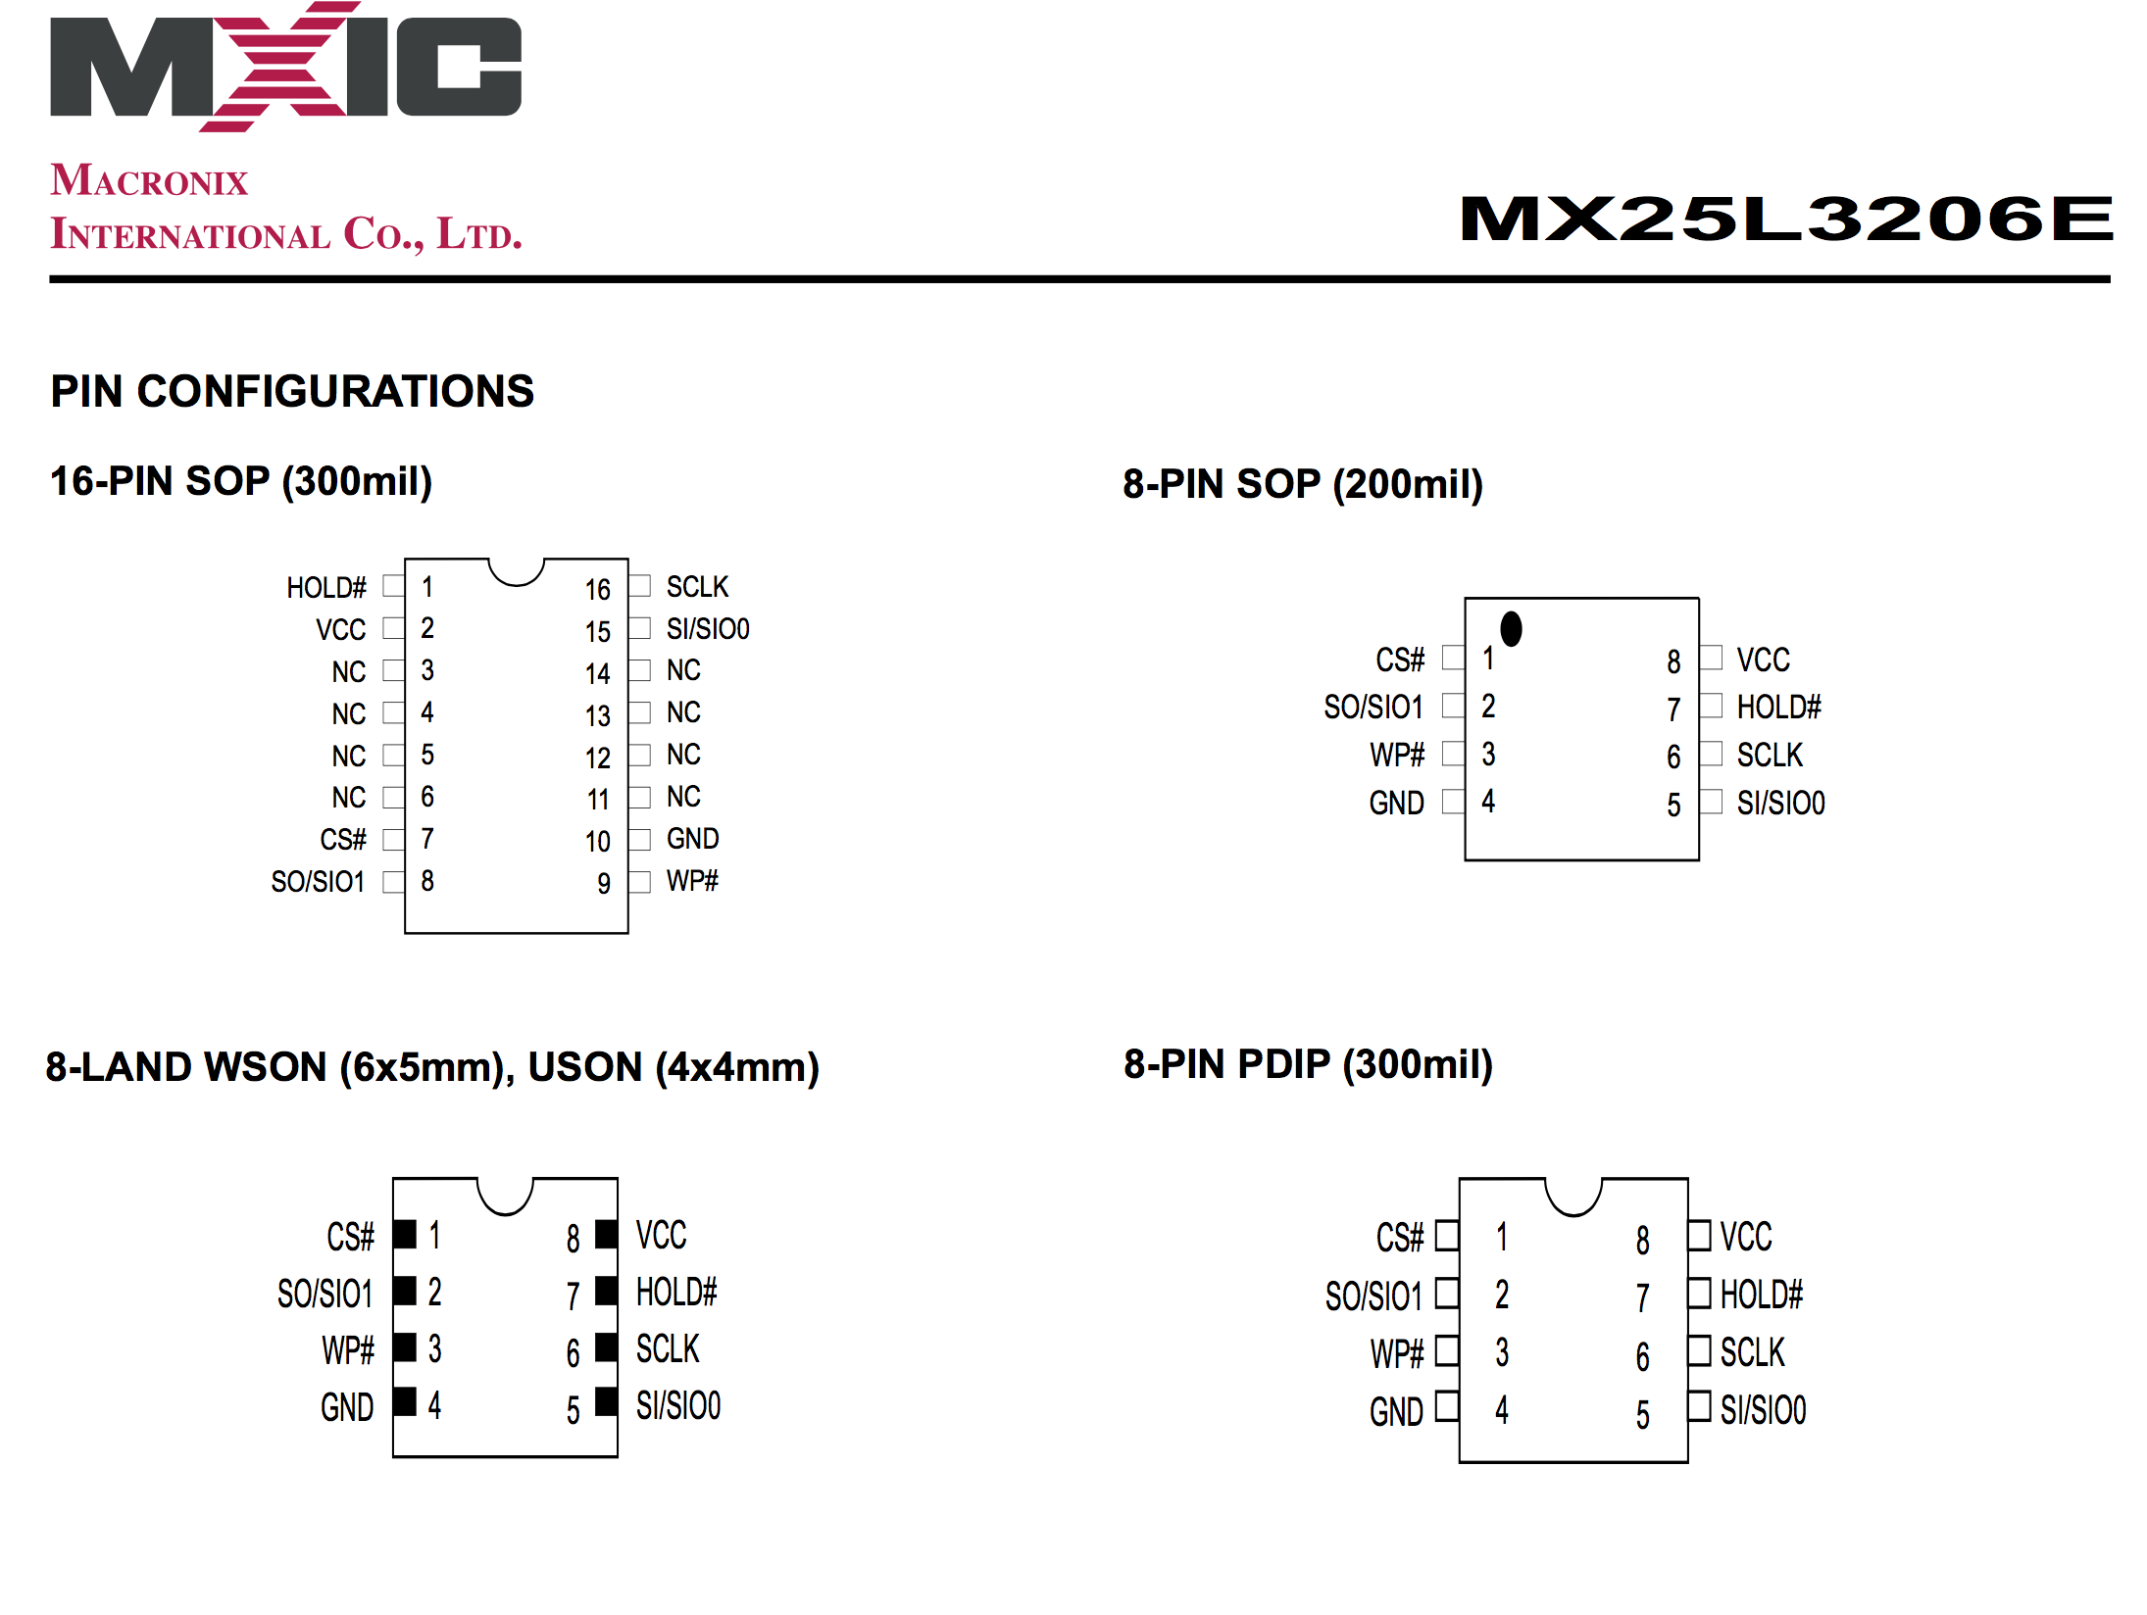
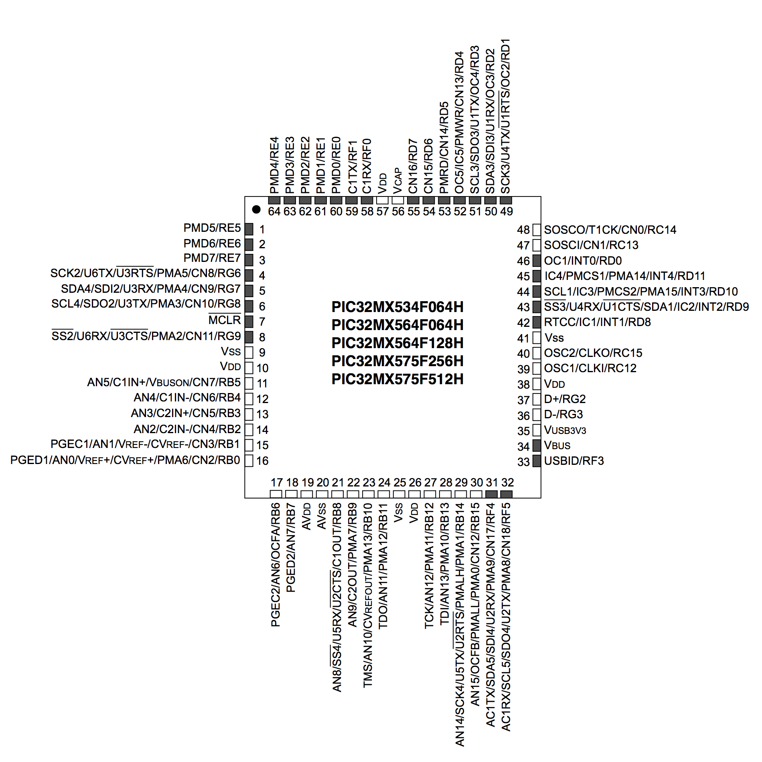
RTFM
Datasheets are your friend!
Notes:
1) MX25L32
2) PIC32MX5

Slide 21
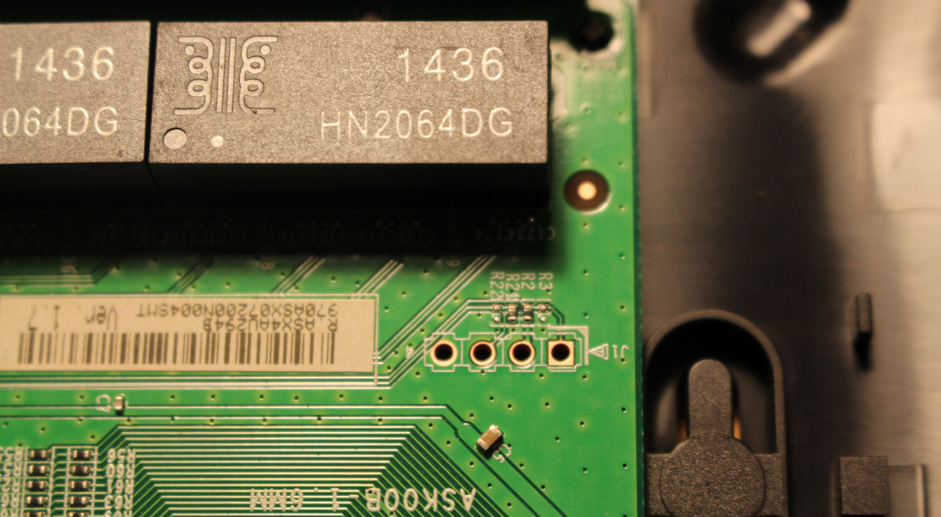
Identifying HW Interfaces

Slide 22
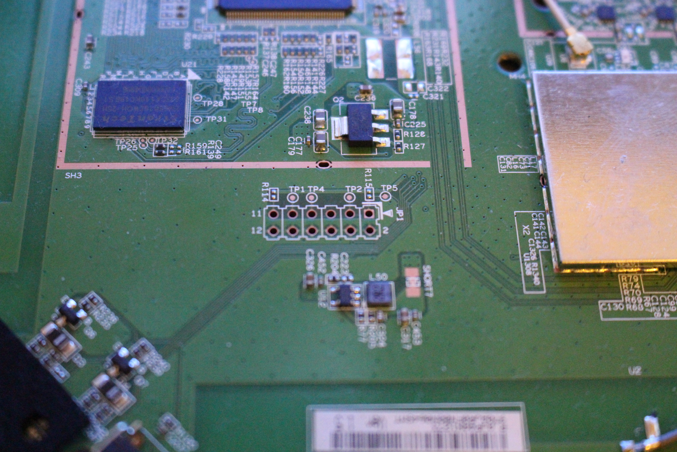

Slide 23
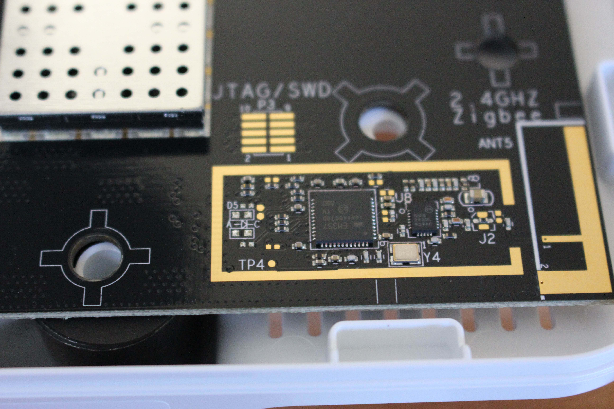

Slide 24


Slide 25
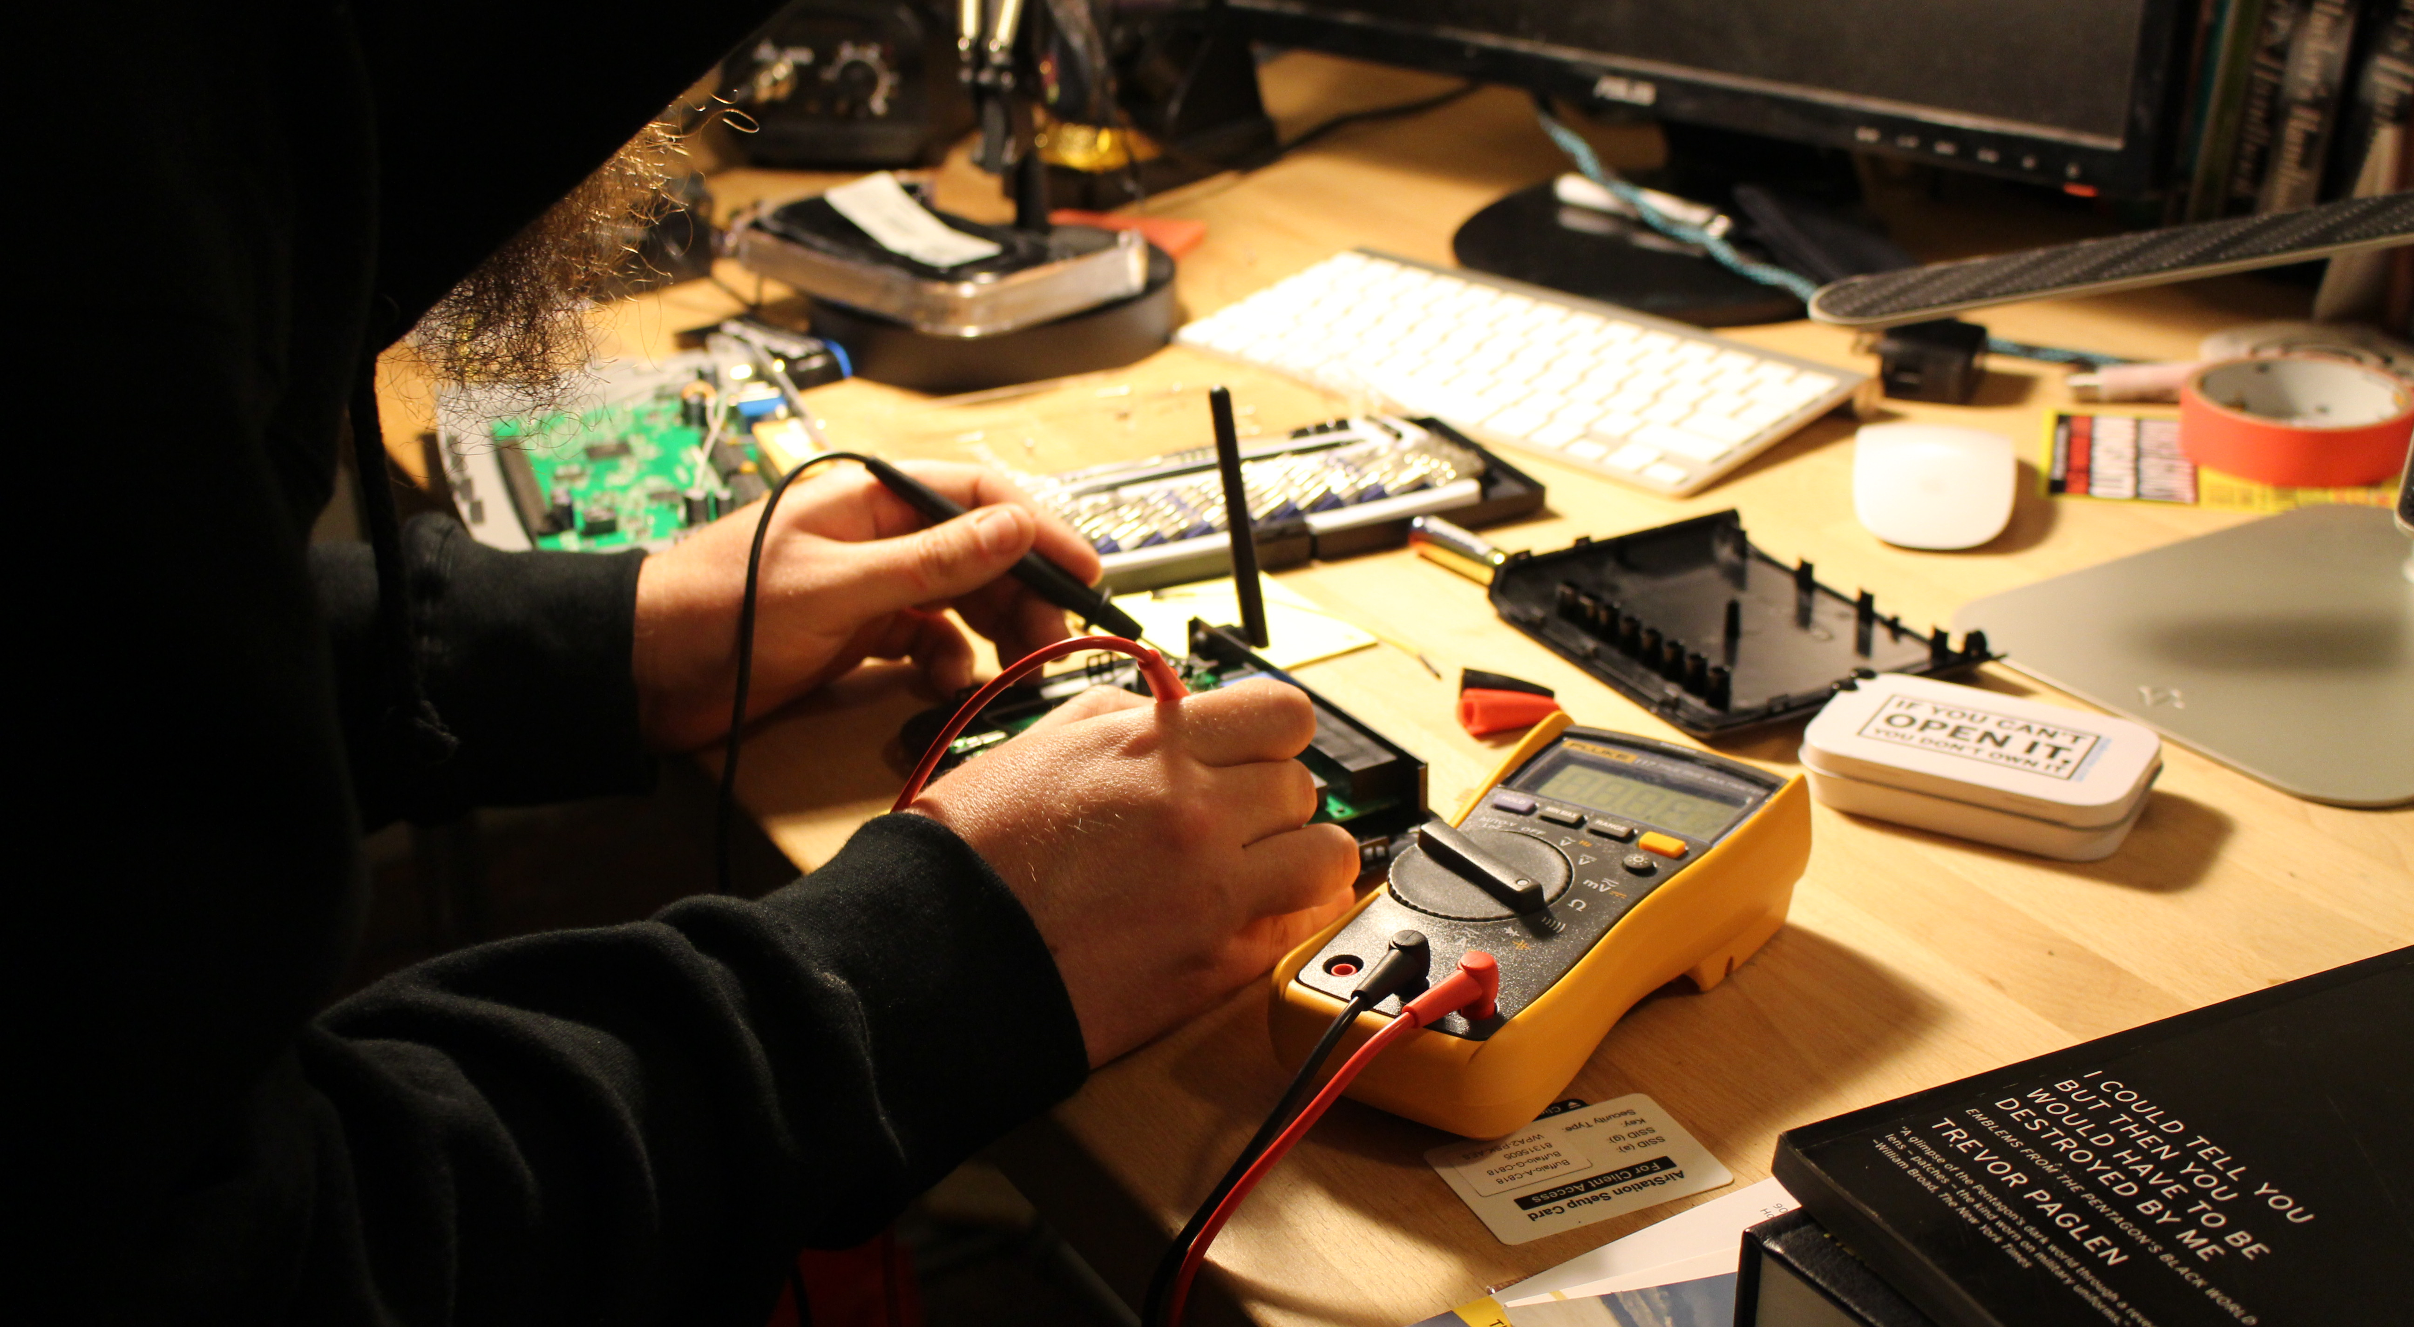
Pinout Reversing

Slide 26
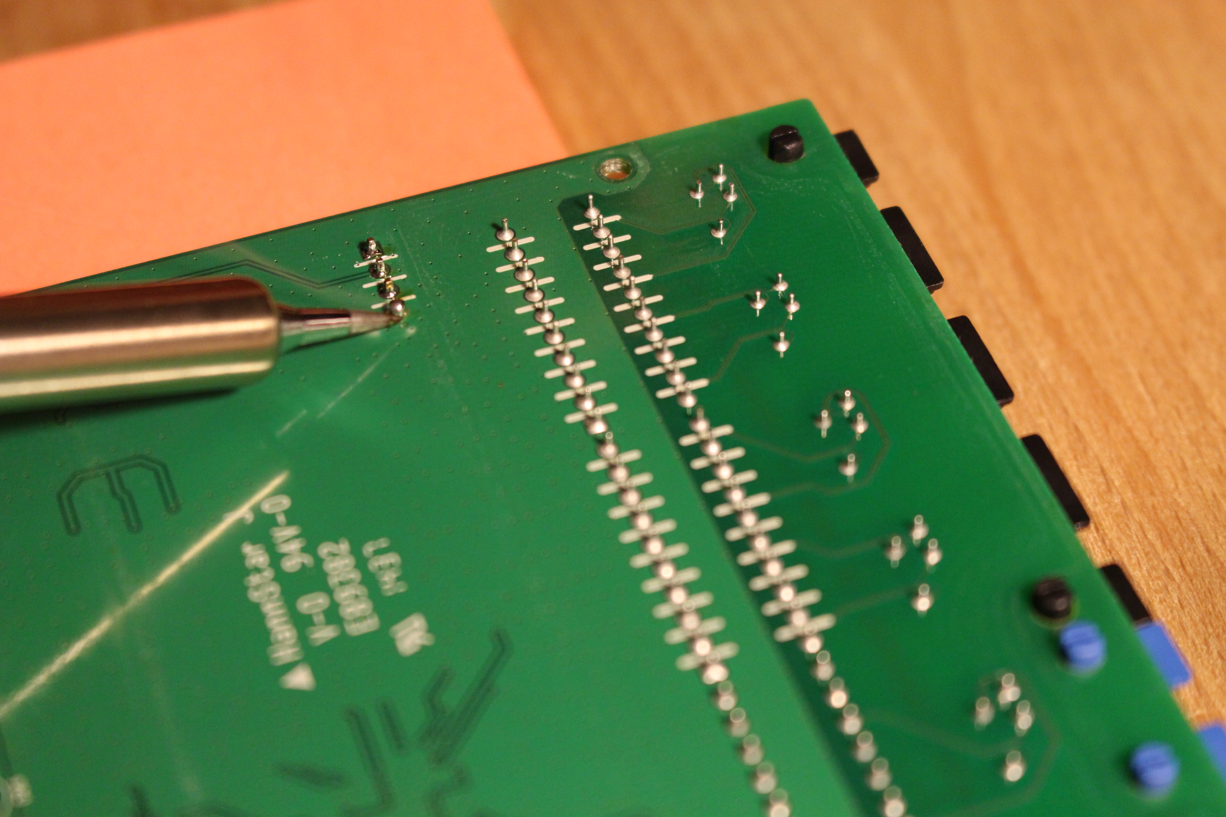

Slide 27
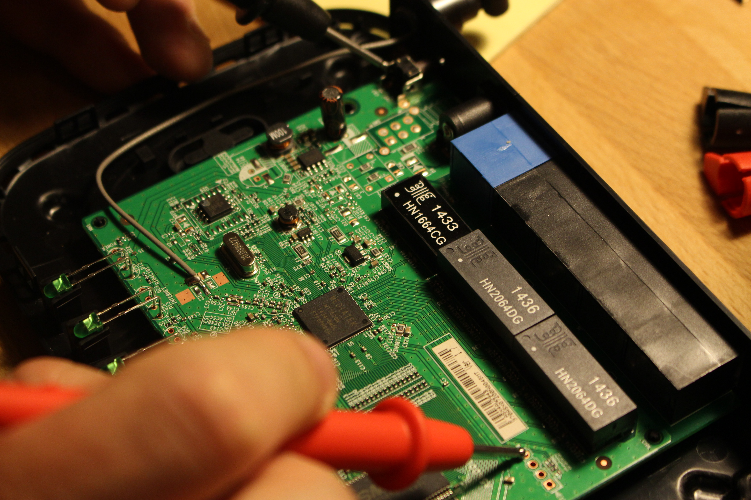

Slide 28
VCC Pin – Steady Voltage (Also chirps)
GND Pin – Metal Piece & Pin
Tx Pin – Fluctuation upon boot
Baudrate

Slide 29
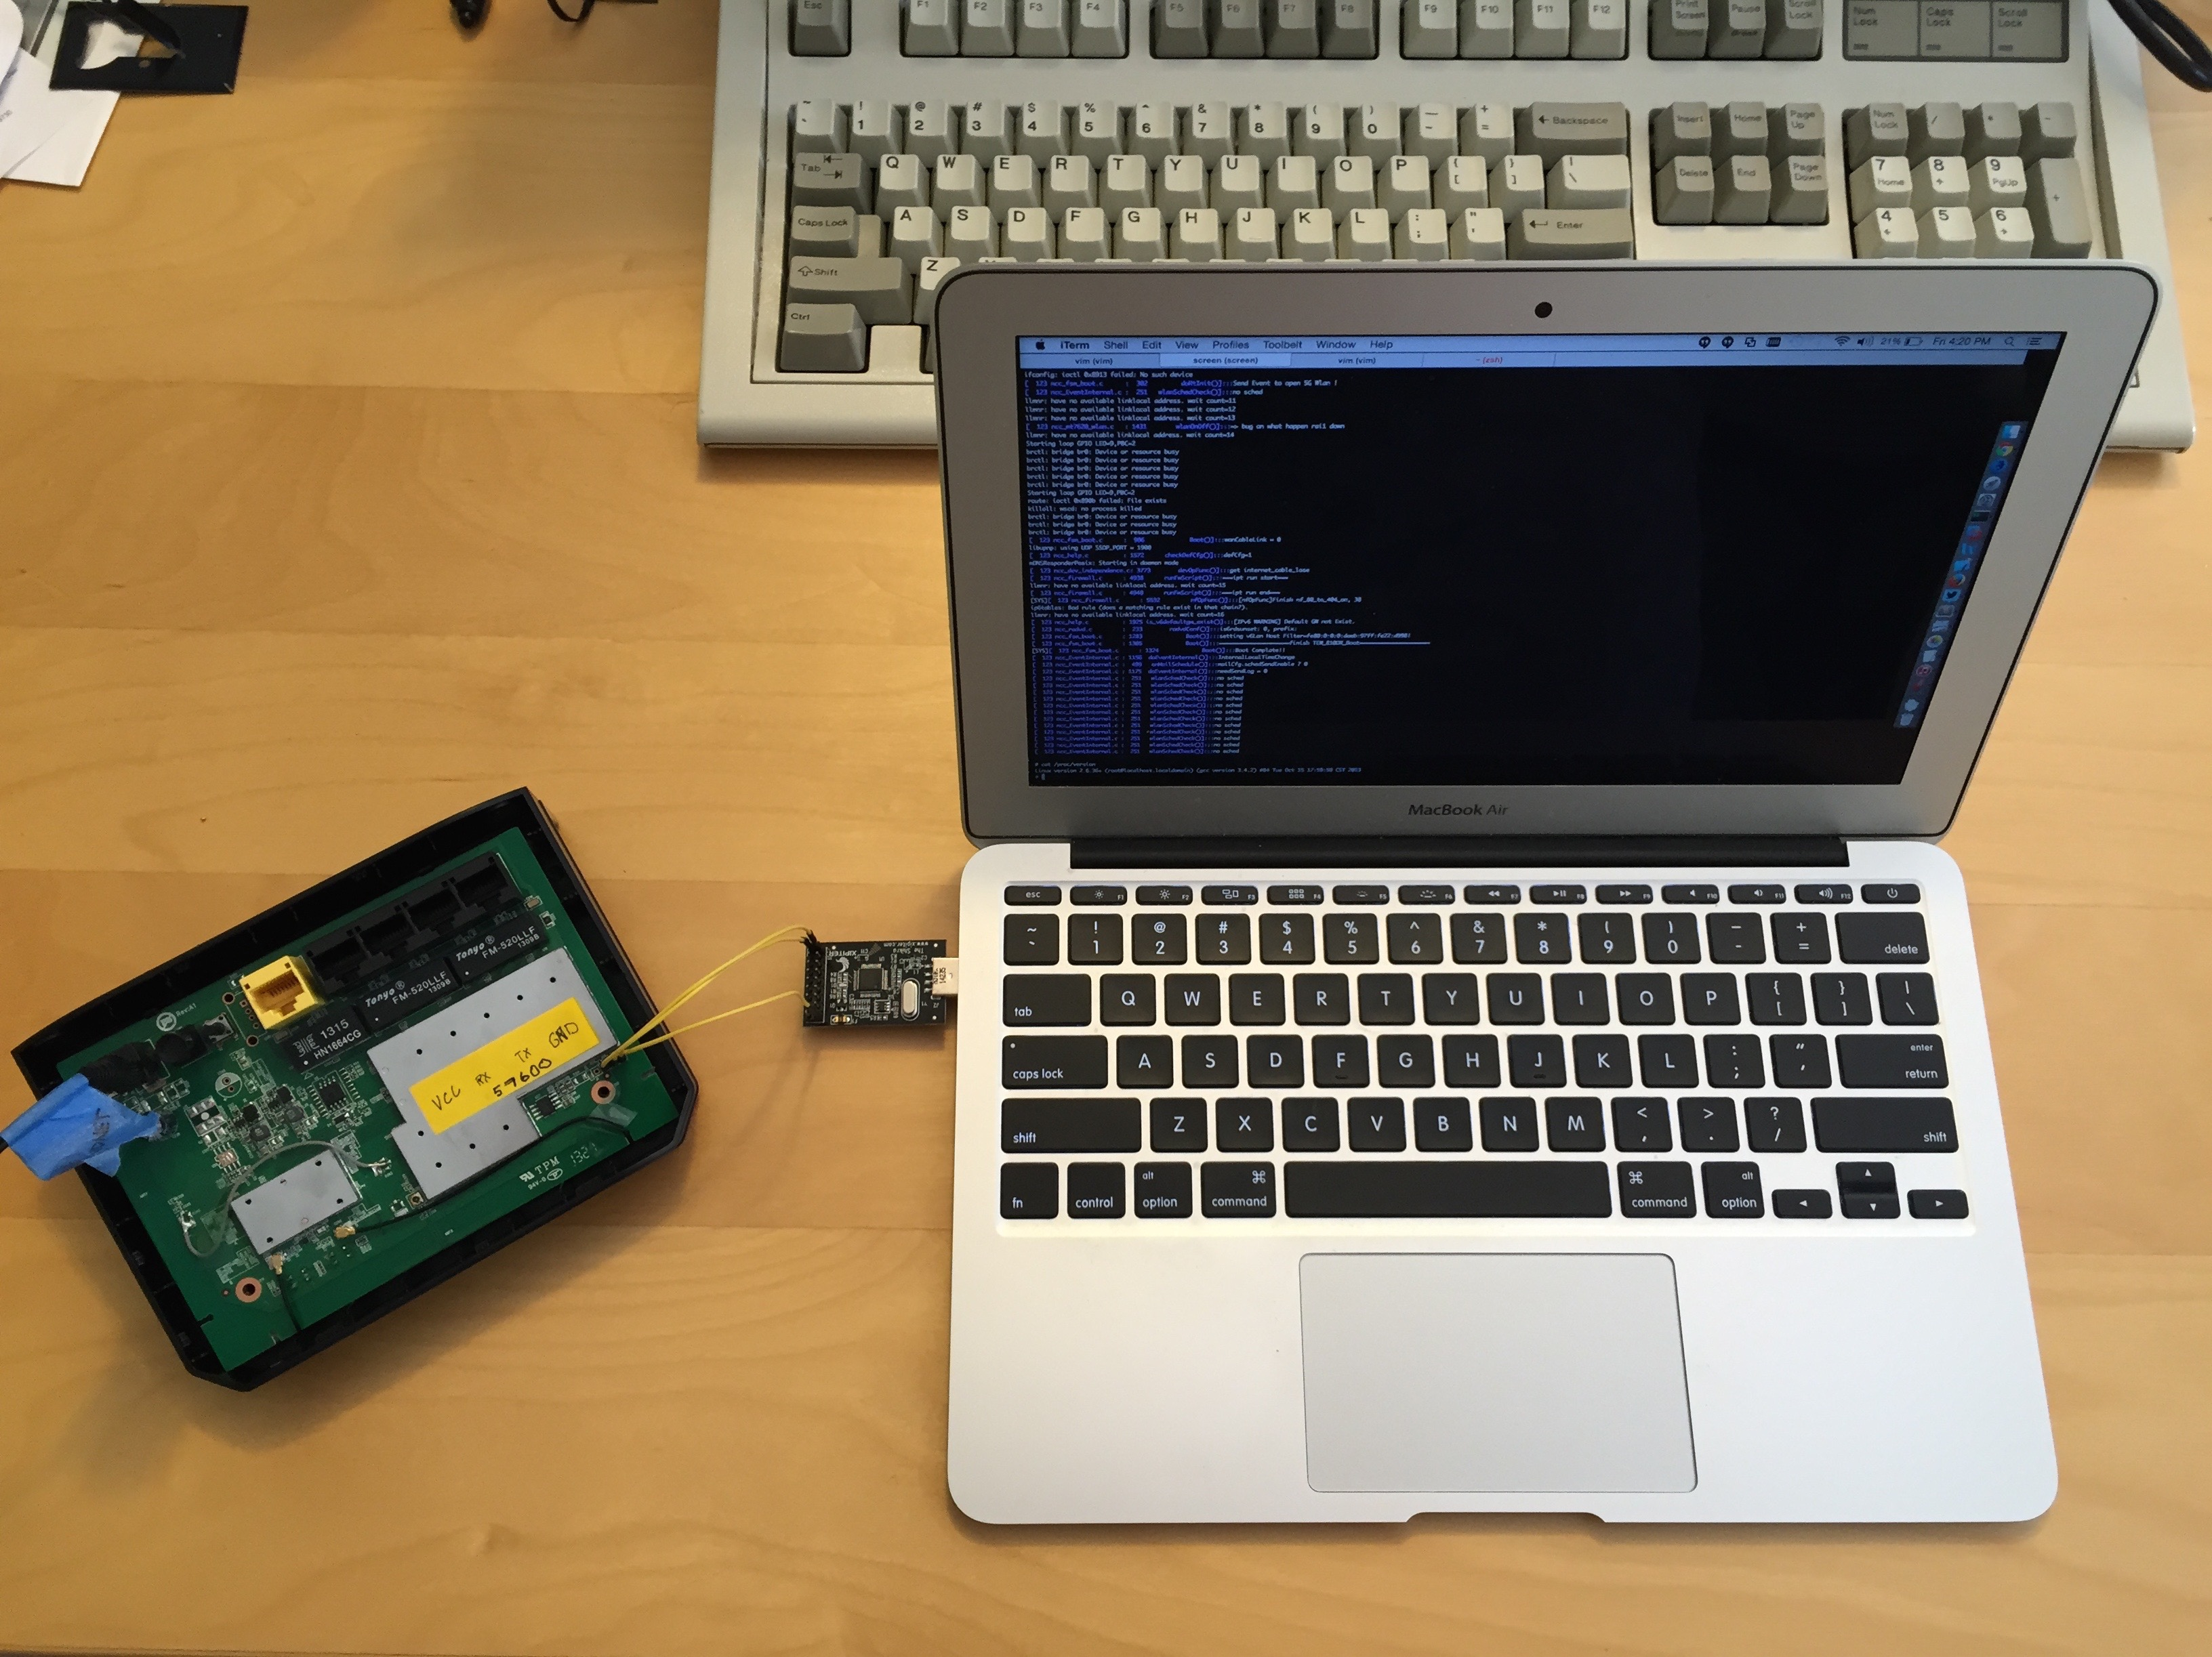
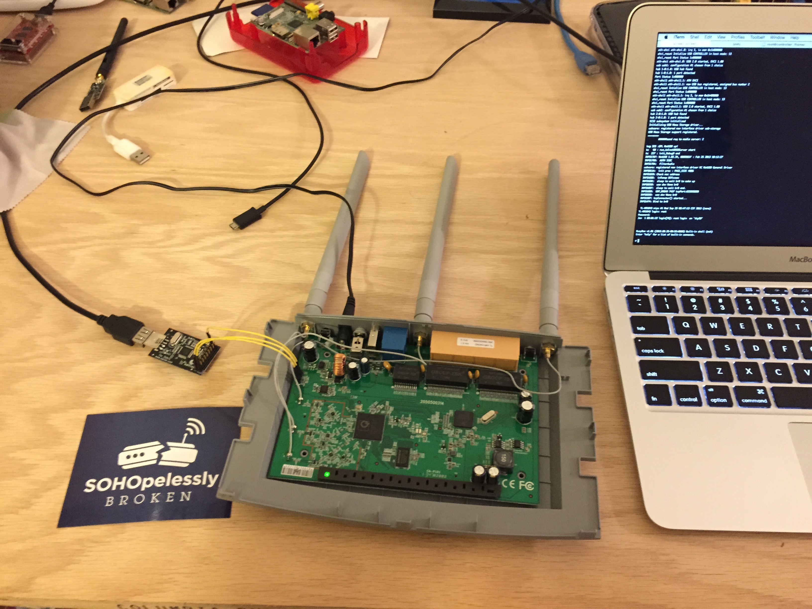
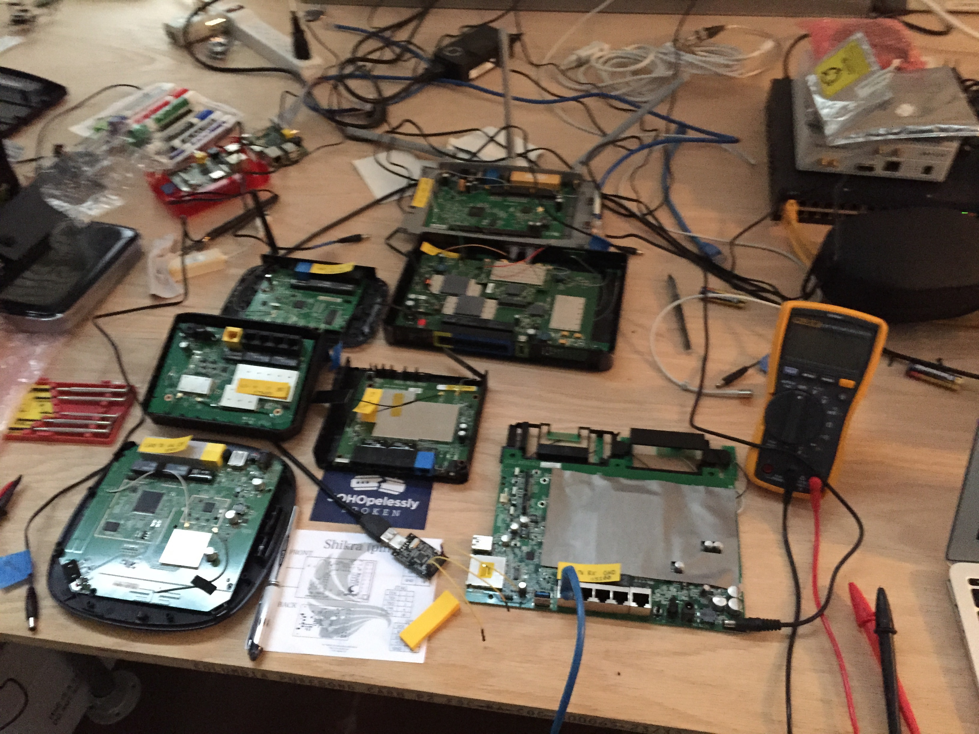
UART to Root Shells

Slide 30
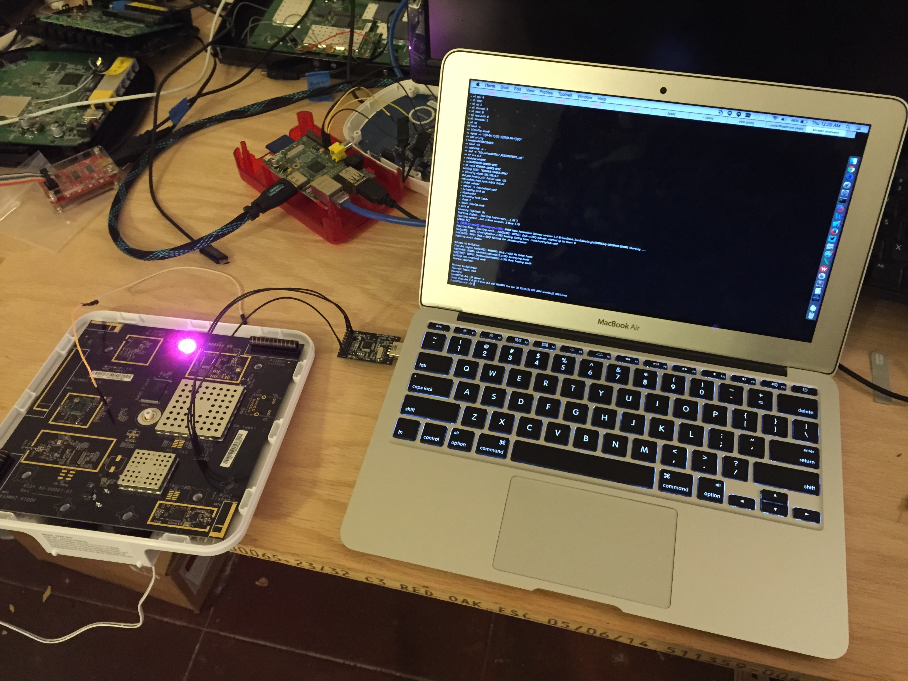

Slide 31
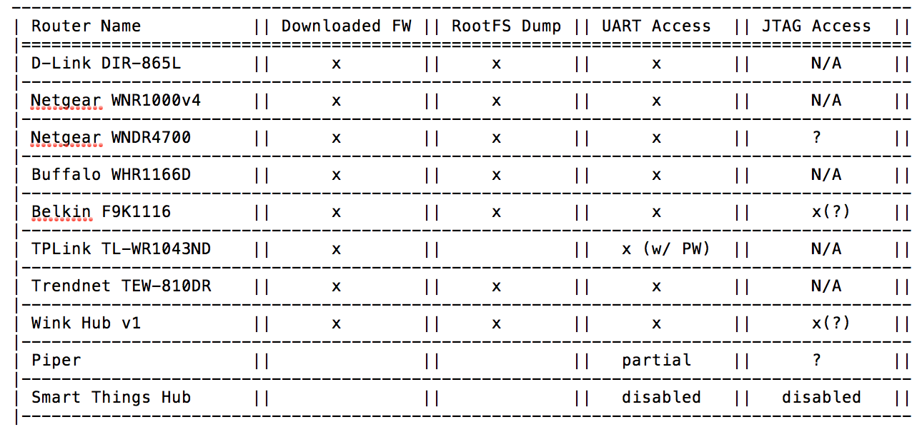

Slide 32
JTAG – Joint Test Action Group
Finding TDI (Test Data In), TDO (Test Data Out), TCK (Test Clock), TMS (Test Mode Select), TRST (Test Reset) optional.
Hardware Debugging via OpenOCD / GDB
Jtagulator is awesome for brute-forcing pinout

Slide 33
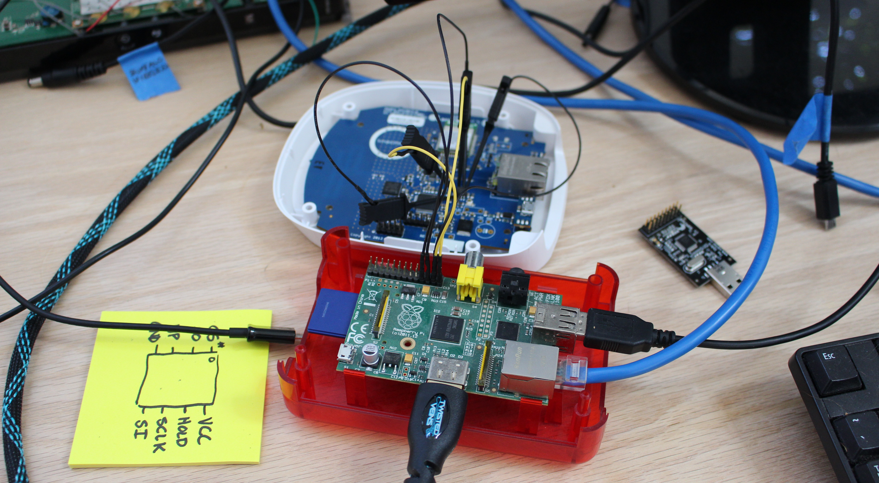
Dumping Flash w/ Flashrom

Slide 34
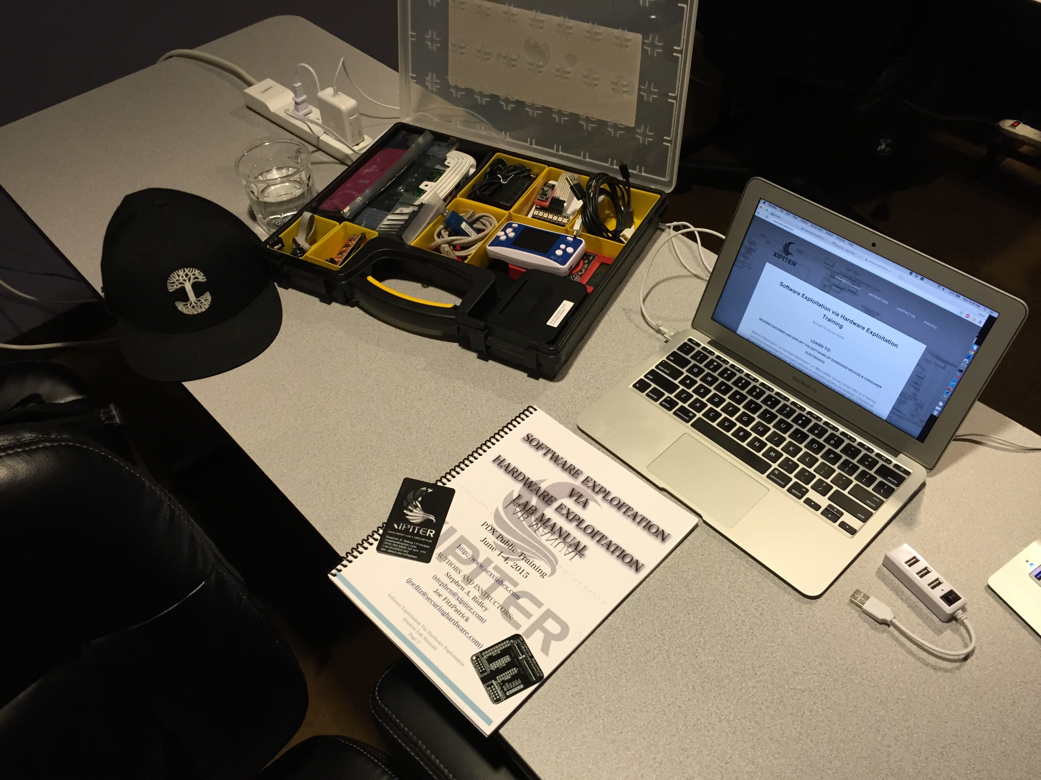
Resources to Learn
Trainings:
SexViaHex.com – Software Exploitation Via Hardware Exploitation - Xipiter
Hands on Hardware Hacking – Joe Grand
Blogs
http://www.devttys0.com/
https://dontstuffbeansupyournose.com

Slide 35
HANDS ON!!
If anyone would like to try wiring up a shikra to a UART interface and playing around with a device.
Presoldered SOHO Routers & Home Automation Hubs

Slide 36
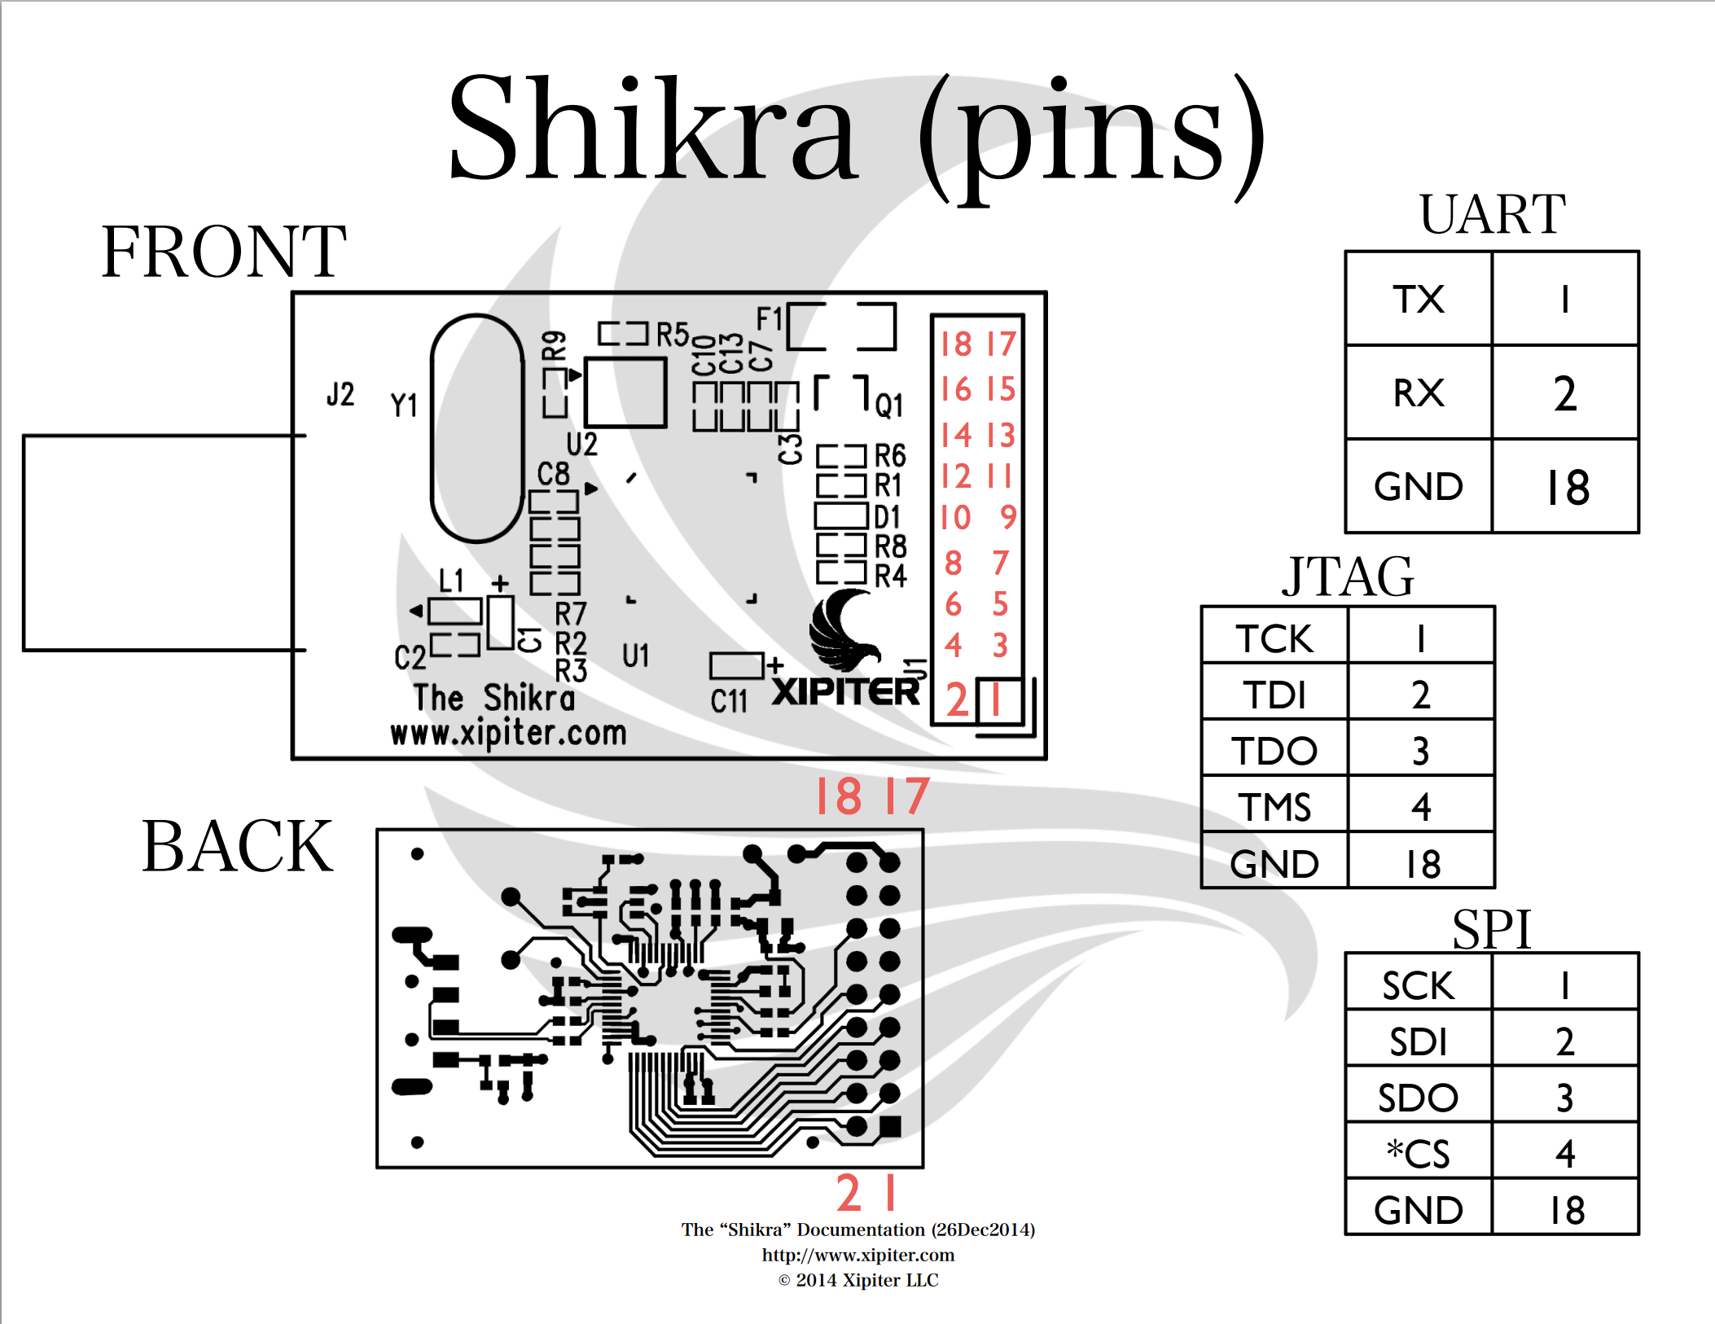

Slide 37
Accessing Shikra via Screen
screen /dev/cu.usbserial-145 115200
^ ^ ^
cmd device name baudrate

Slide 38
Your Turn!
Enable yourself as a security researcher.
Initial access for further research.
You can do it too! Its fun!

Slide 39


Thank You!
DEF CON / @IoTVillage / You!
Contact ISE -- https://securityevaluators.com/
→ https://github.com/f47h3r/firmware_collection
→ @f47h3r_b0

Slide 40


Get Involved

